Slide 1
OwO Meow Art Gallery
Online Art Gallery Store
Chia Ming Yi 24WMR09040
Ong Yi Xin 24WMR09097
Lim Jun Wei 24WMR09078
Ng Ian Kai 24WMR09090

Slide 2
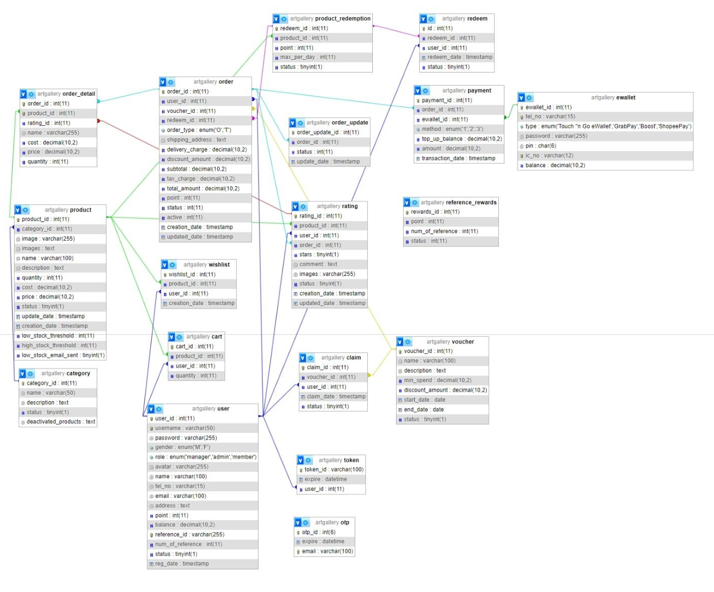
Entity Relationship Diagram (ERD)

Slide 3
1. Chia Ming Yi

Slide 4
Chia Ming Yi
Security
Roles: Admin + Manager + Member
Login + Logout
Password Hashing
Reset Password
Email OTP Verification
Remember Me
Temporary Login Blocking (3 Attempts)
Captcha Integration
Dashboard
Member + Admin + Manager Dashboard
Data Charts for summary report
Top 10 Sales Report
Nit Profit Summary Report
Ajax Integration

Slide 5
Chia Ming Yi
Member Profile
Profile Update
Password Update
Profile Photo Upload by selecting photo
Profile Photo Upload by webcam capture photo
Member Maintenance
Member Registration (Member)
Bilingual Support
English & Chinese (Admin)

Slide 6
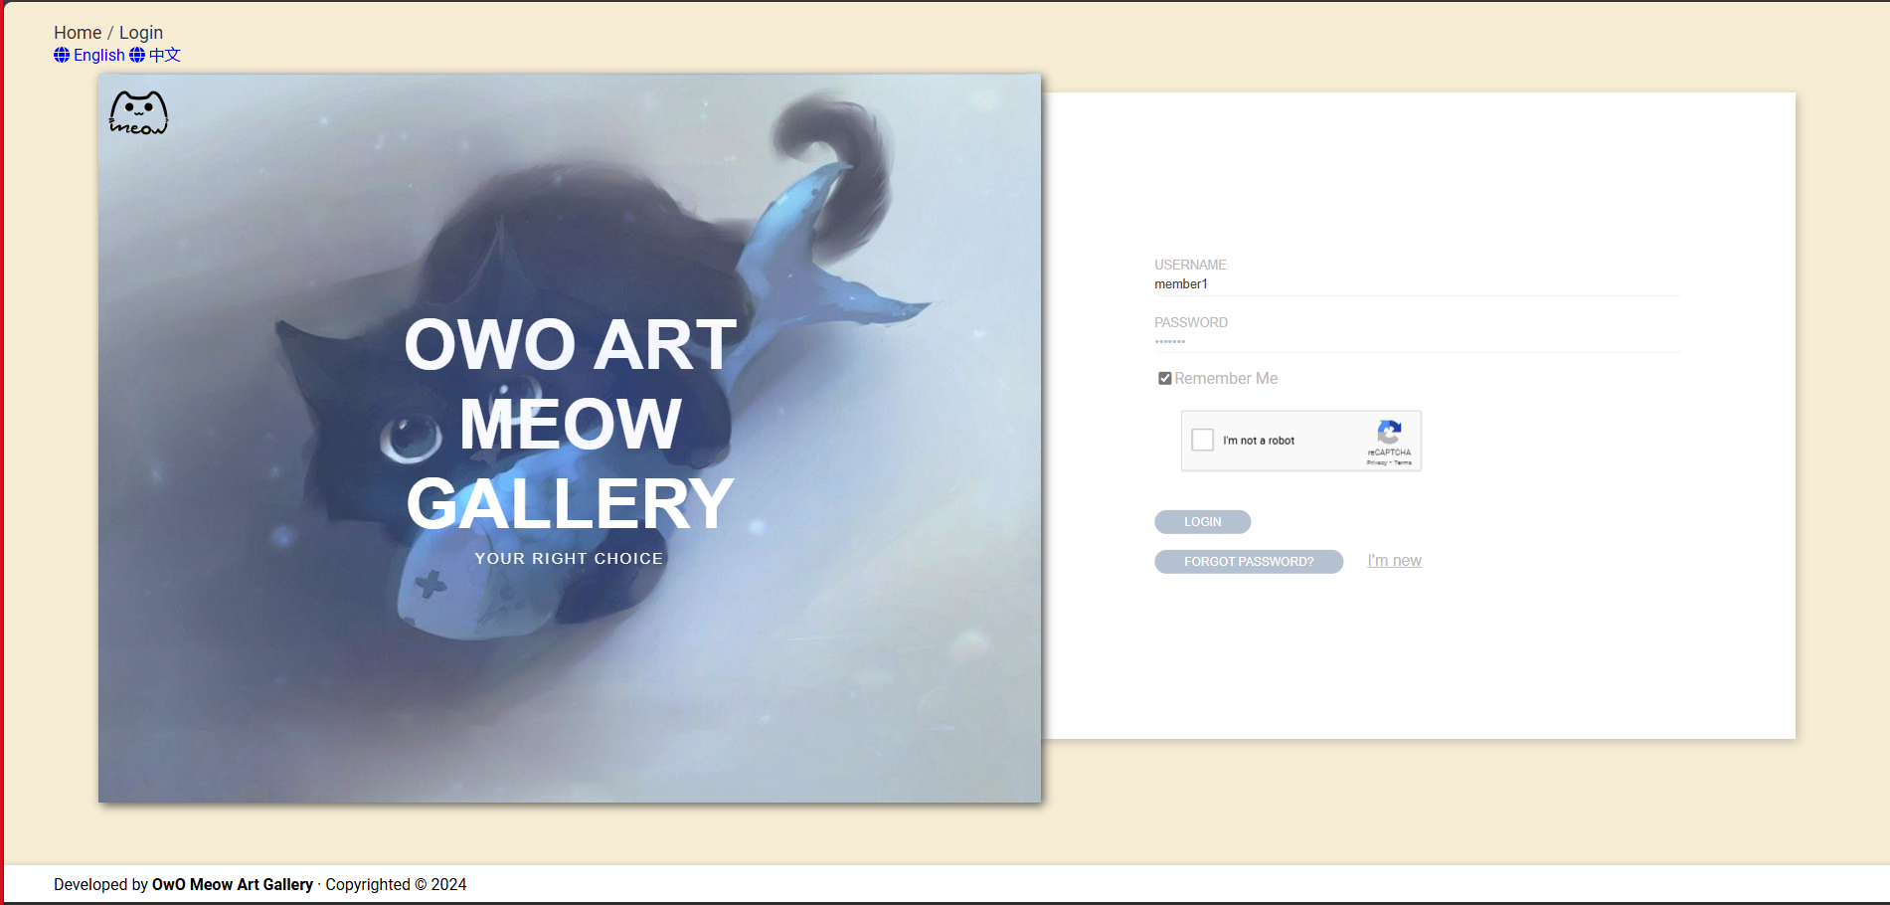
Login Page

Slide 7
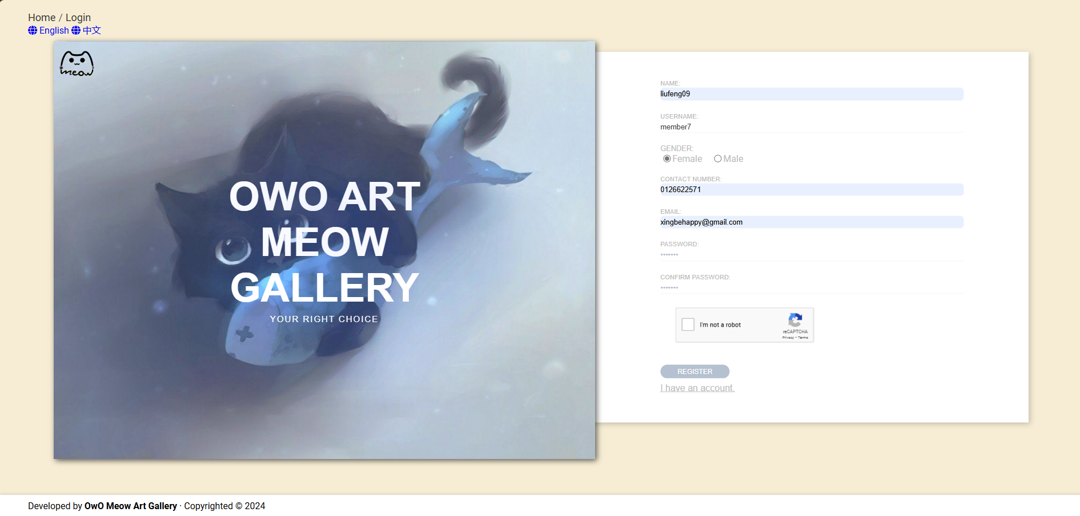
Register Page

Slide 8
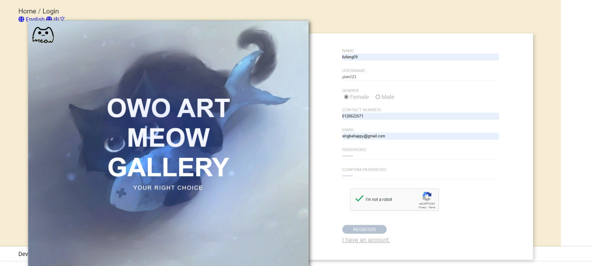
Email OTP Verifyication Page [1]

Slide 9
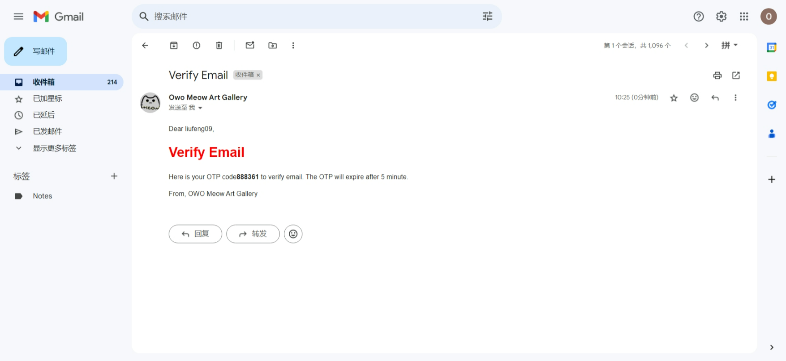
Email OTP Verifyication Page [2]

Slide 10
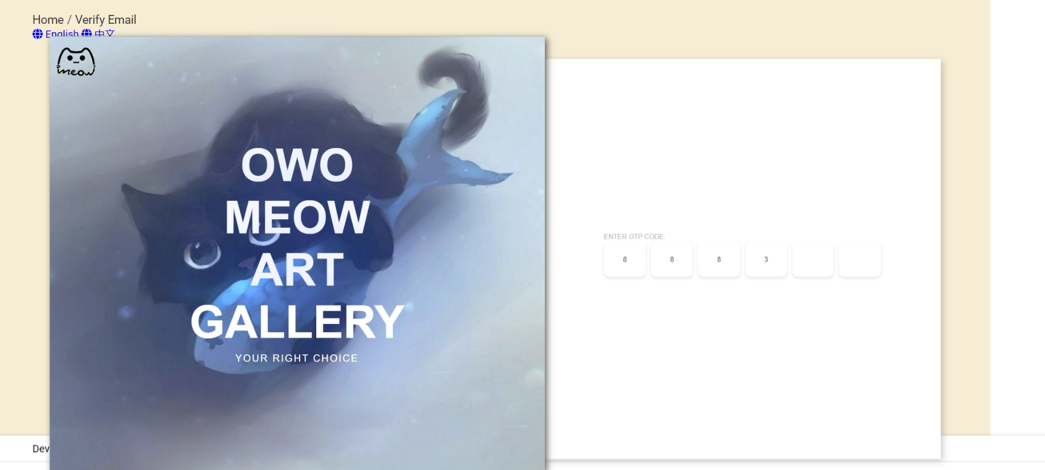
Email OTP Verifyication Page [3]

Slide 11
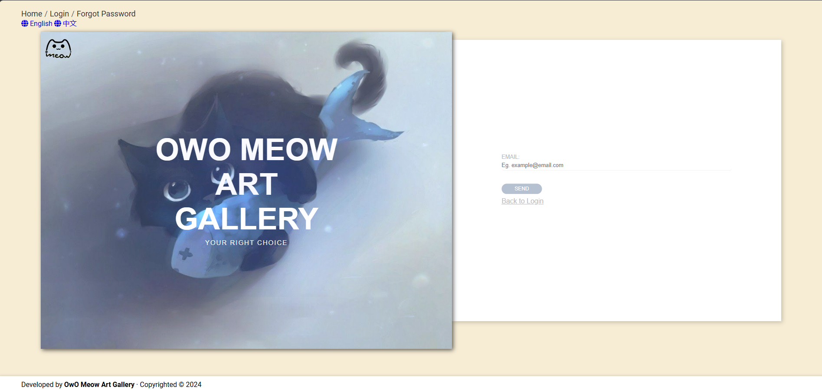
Enter Email for Reset Password Page

Slide 12
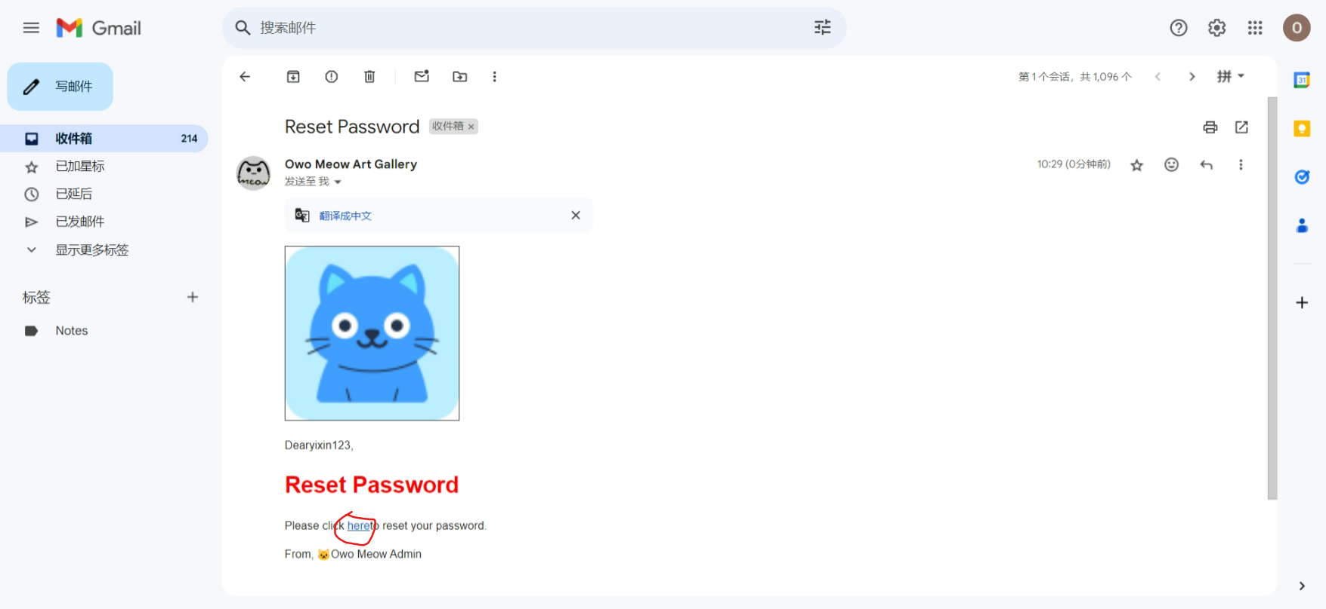
Email with link for go reset password Page

Slide 13
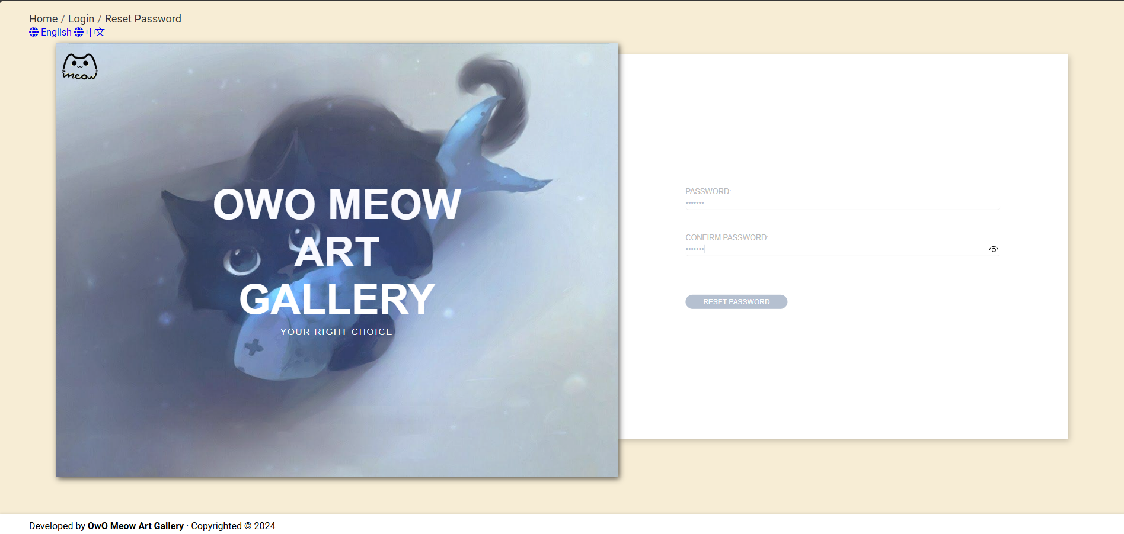
Reset Password Page

Slide 14
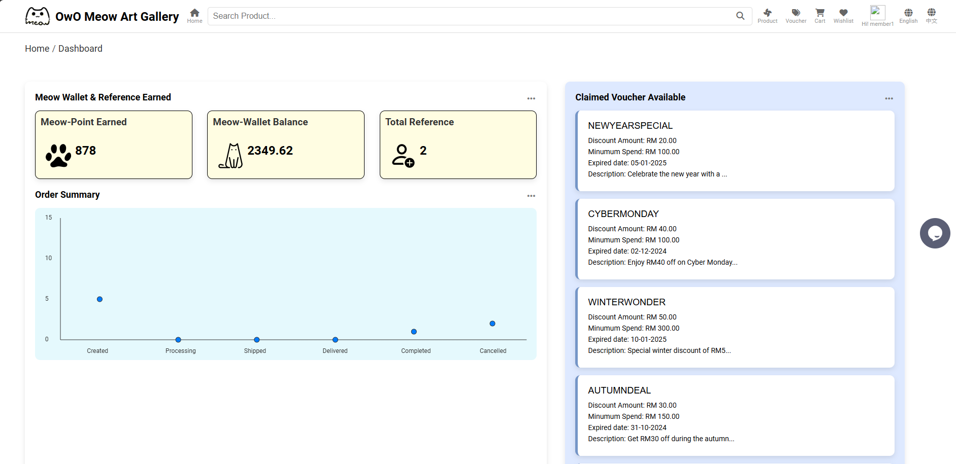
Member Dashboard Page

Slide 15
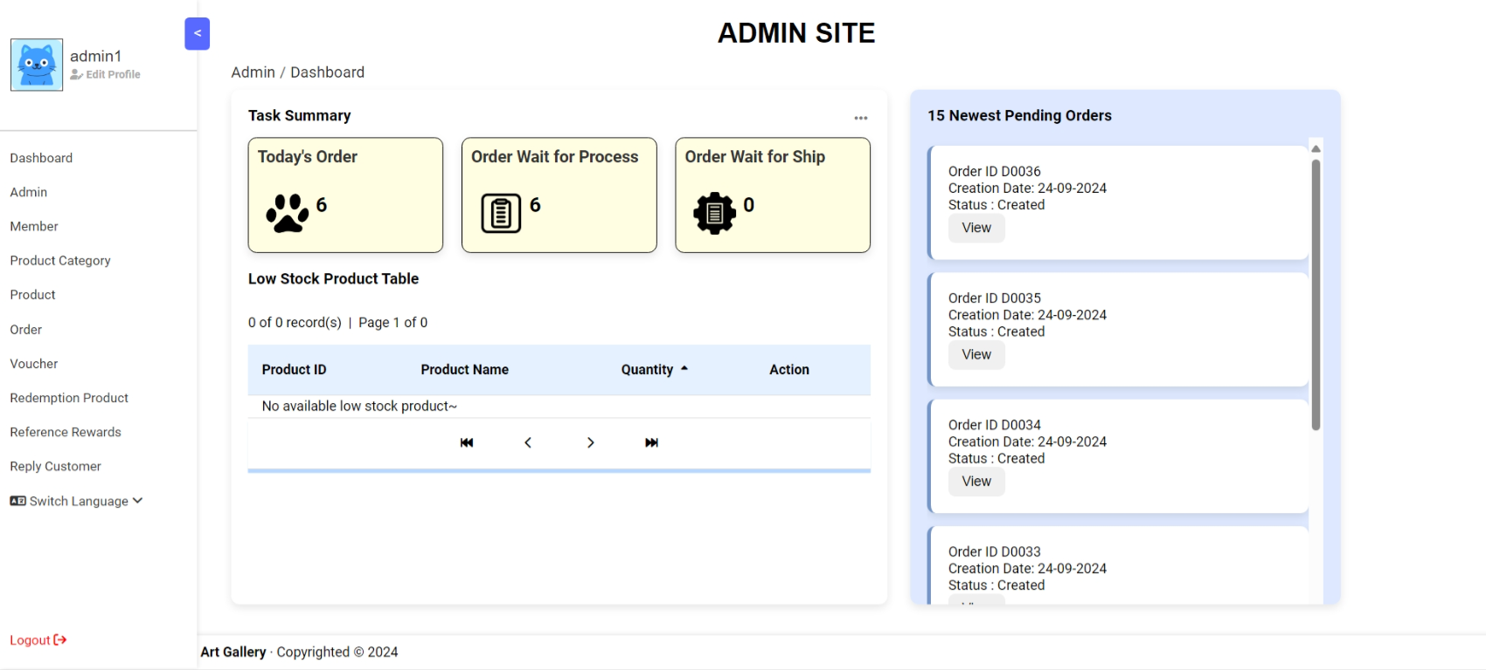
Admin Dashboard Page

Slide 16
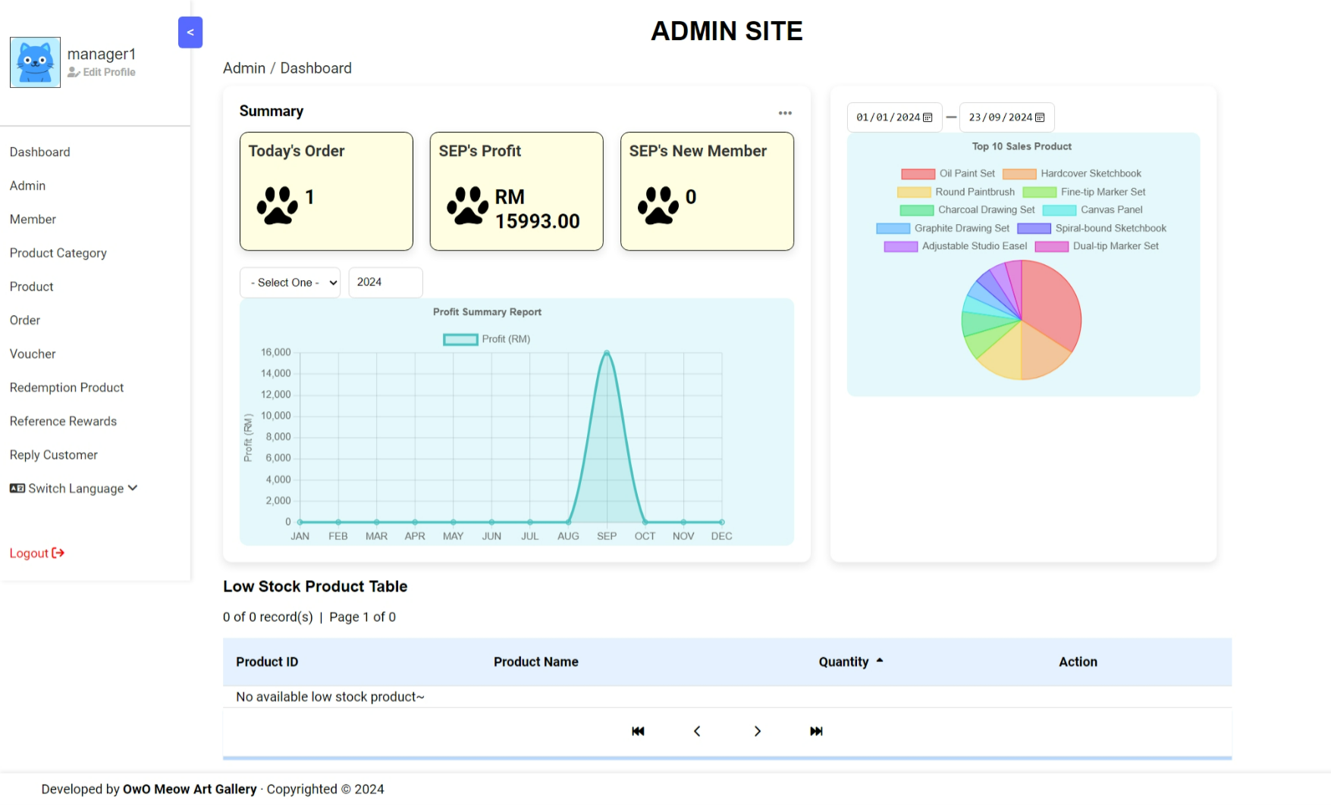
Manager Dashboard Page

Slide 17
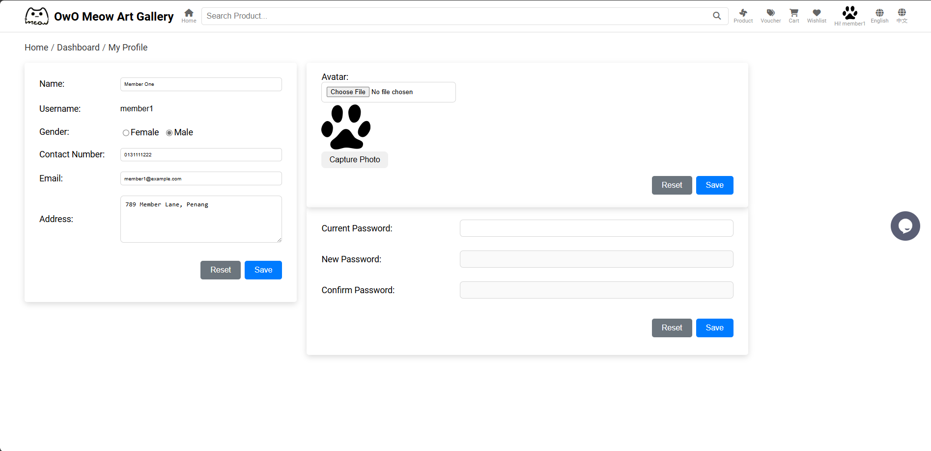
Member Profile Update Page

Slide 18
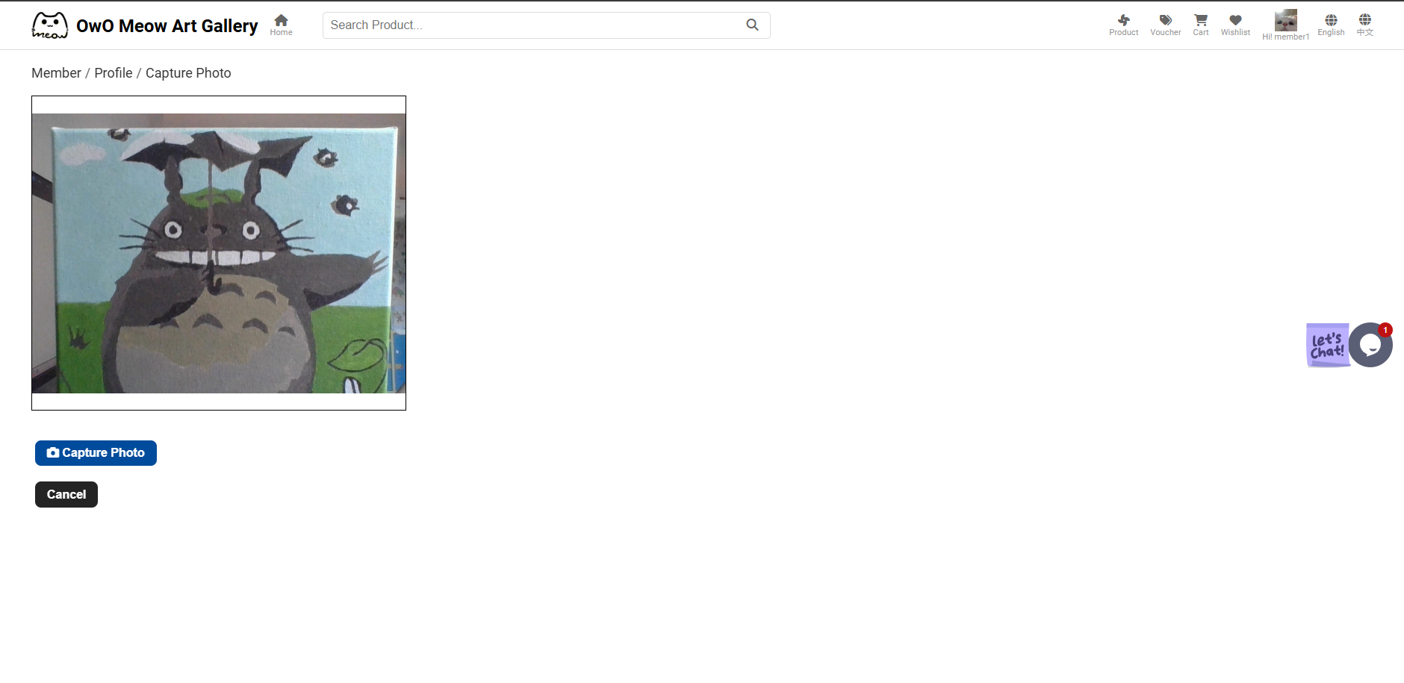
Member Profile Photo Capture Page

Slide 19
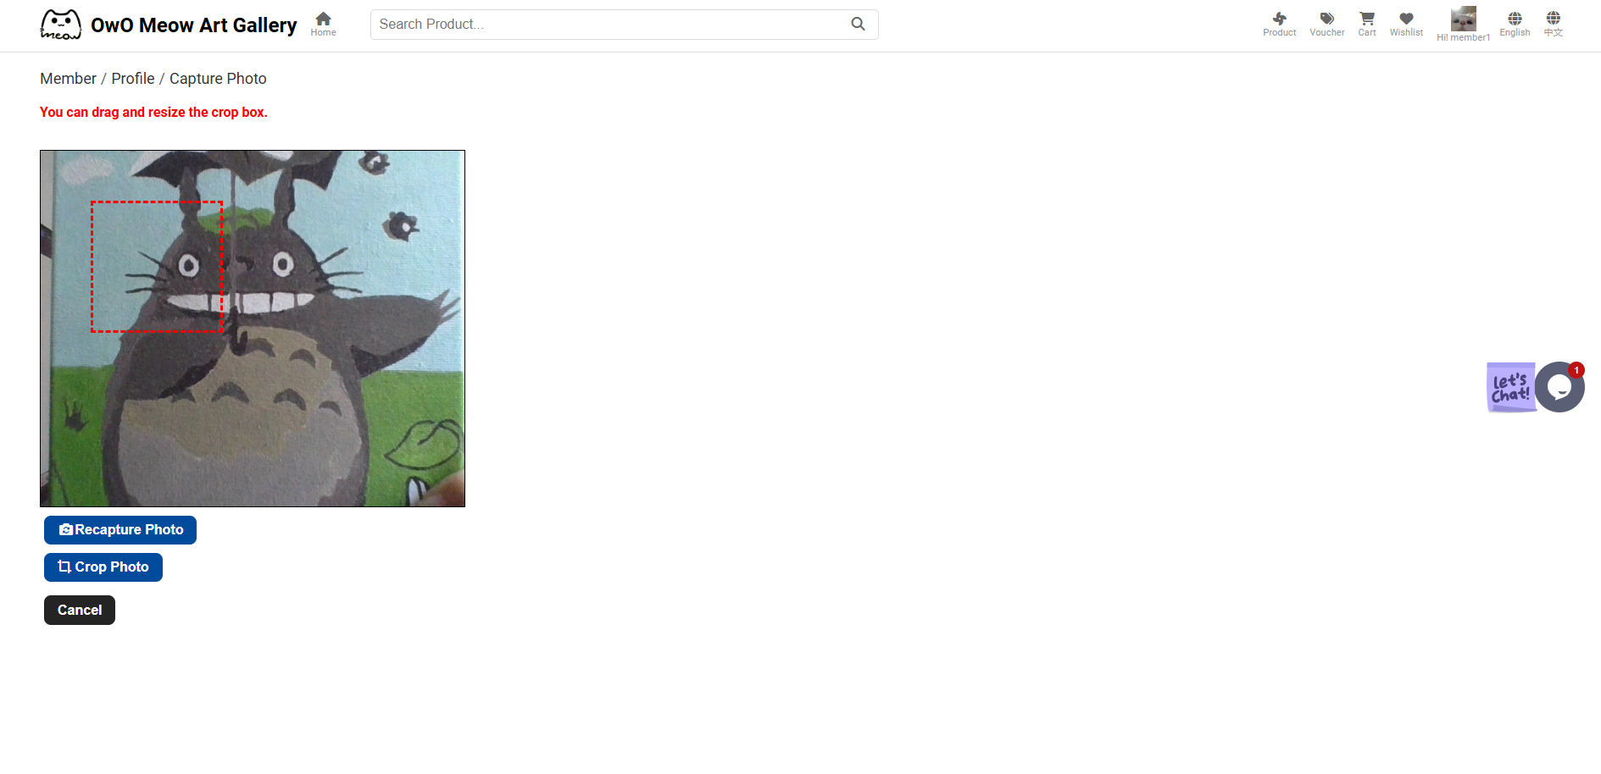
Member Profile Captured Photo Crop Page

Slide 20
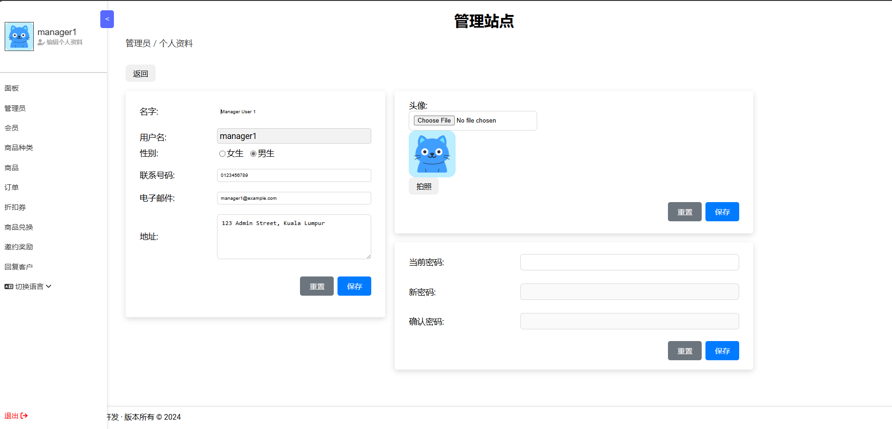
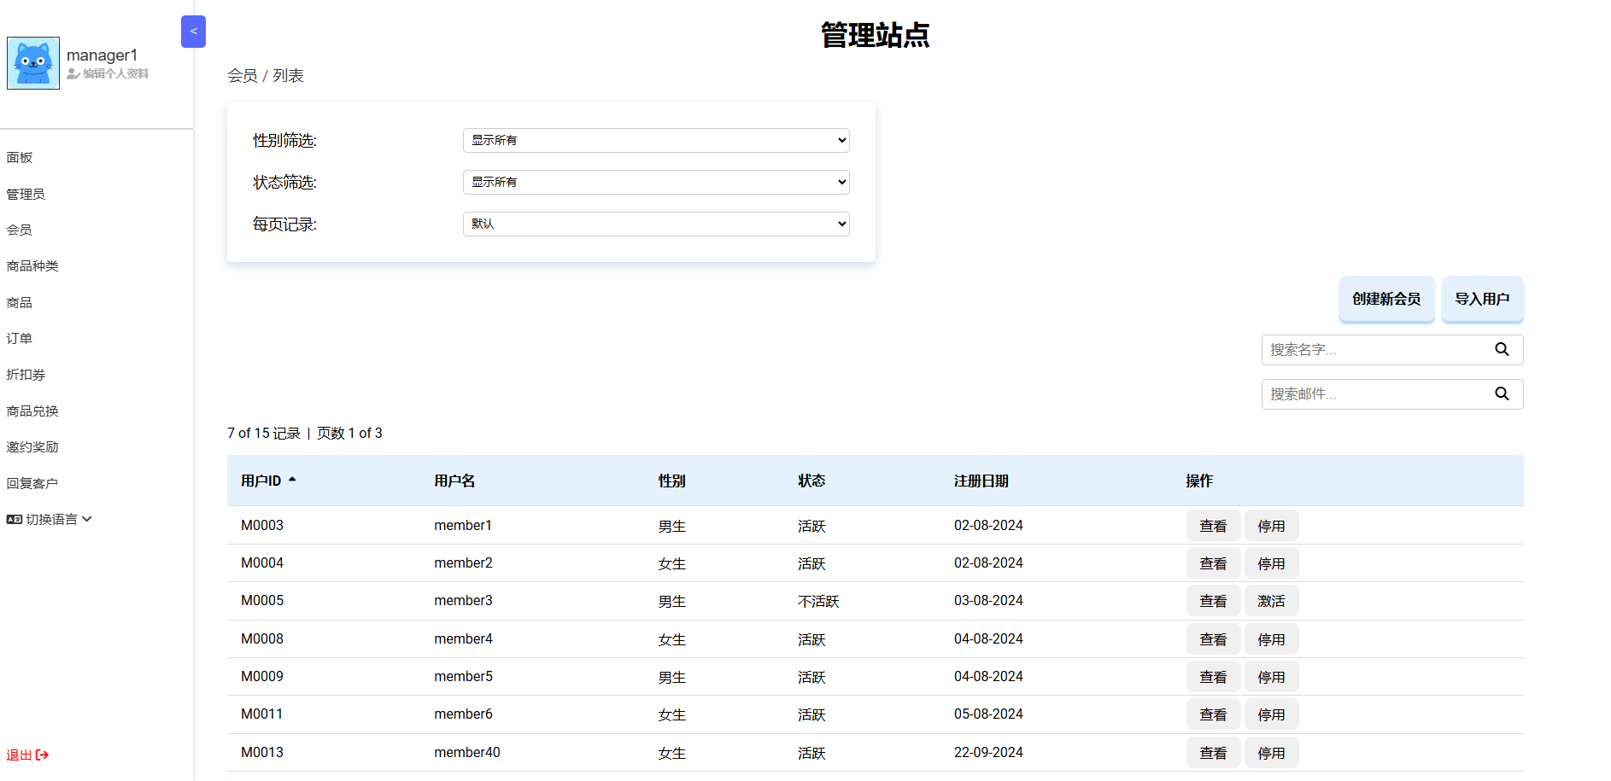
Bilingual Support (Admin) Example Page [1]

Slide 21
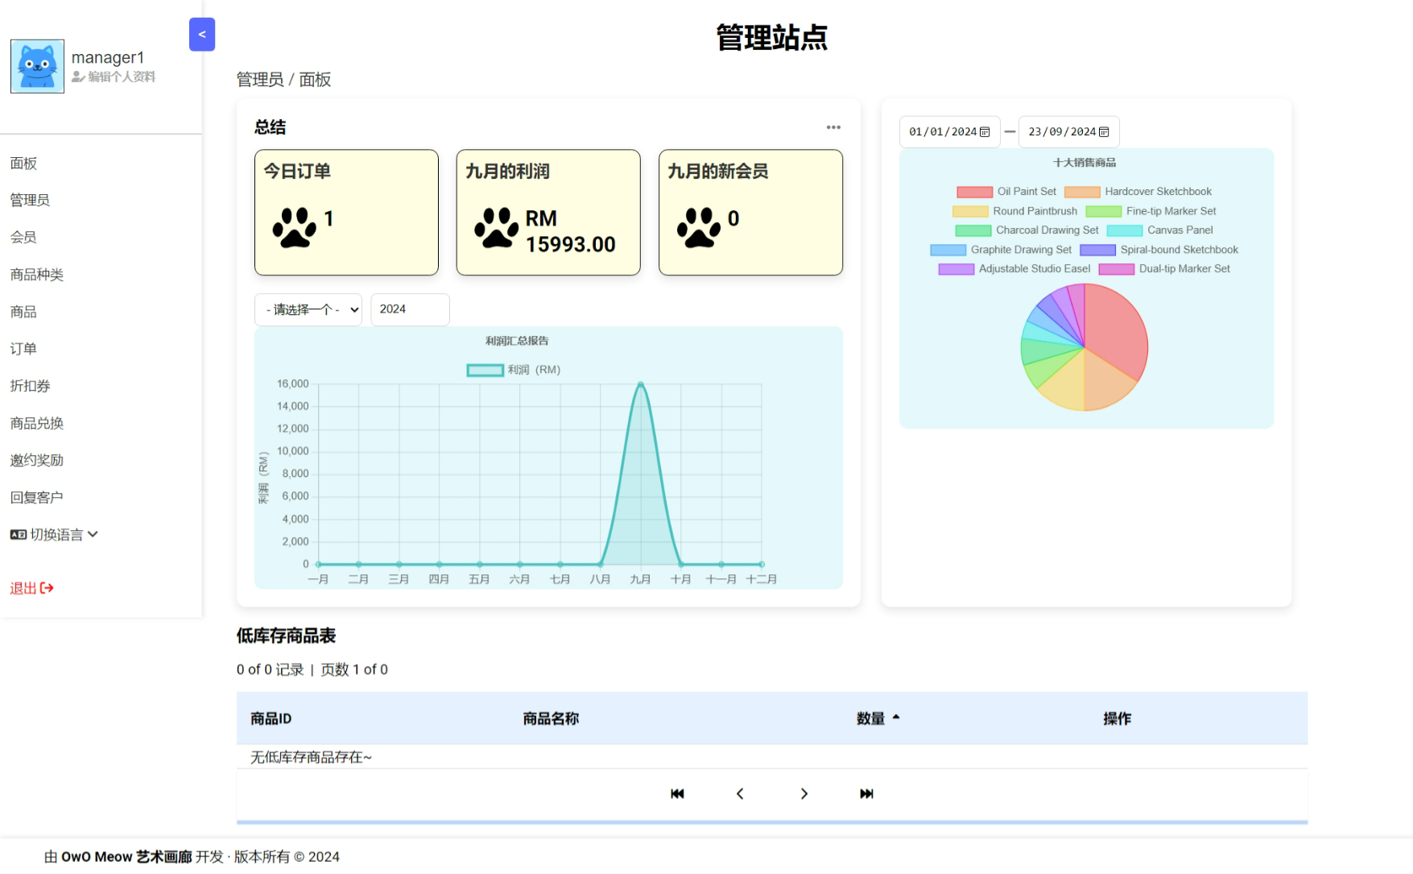
Bilingual Support (Admin) Example Page [2]

Slide 22
2. Ong Yi Xin

Slide 23
2. Ong Yi Xin
Member Maintenance (Admin)
Member Listing + Detail
Basic Searching
Member Detail Editing
Member Profile Photo Upload
Member Registration
Filtering, Sorting, Searching and Paging
Batch Insertion (From CSV)
Ajax Integration
Admin & Manager Profile
Profile Update
Password Update
Profile Photo Upload by selecting photo
Profile Photo Upload by webcam capture photo
Admin & Manager Maintenance
Batch Insertion (From CSV)

Slide 24
2. Ong Yi Xin
Reward Point Handling
Redeem Product
Periodically Check product redeemed expired status and update
Top Up Maintenance
Top Up Amount Balance (Member)
Top Up History Listing
Ajax Integration
Discount Voucher Handling
Voucher Management (CRUD - Admin)
Voucher Listing + Detail
Claim Voucher (Member)
Periodically Check Voucher Status and Update
Filtering, Sorting, Searching and Paging (Combined)
Ajax Integration

Slide 25
2. Ong Yi Xin
Member Reference Maintenance
Generate Reference QR code
Reward handling after reference success
Reference Reward Listing + Detail (Admin)
CRUD (Admin)
Filtering, Sorting, Searching and Paging (Admin)
Ajax Integration
Real-Time Chat
Tawk.to live-chat integration

Slide 26
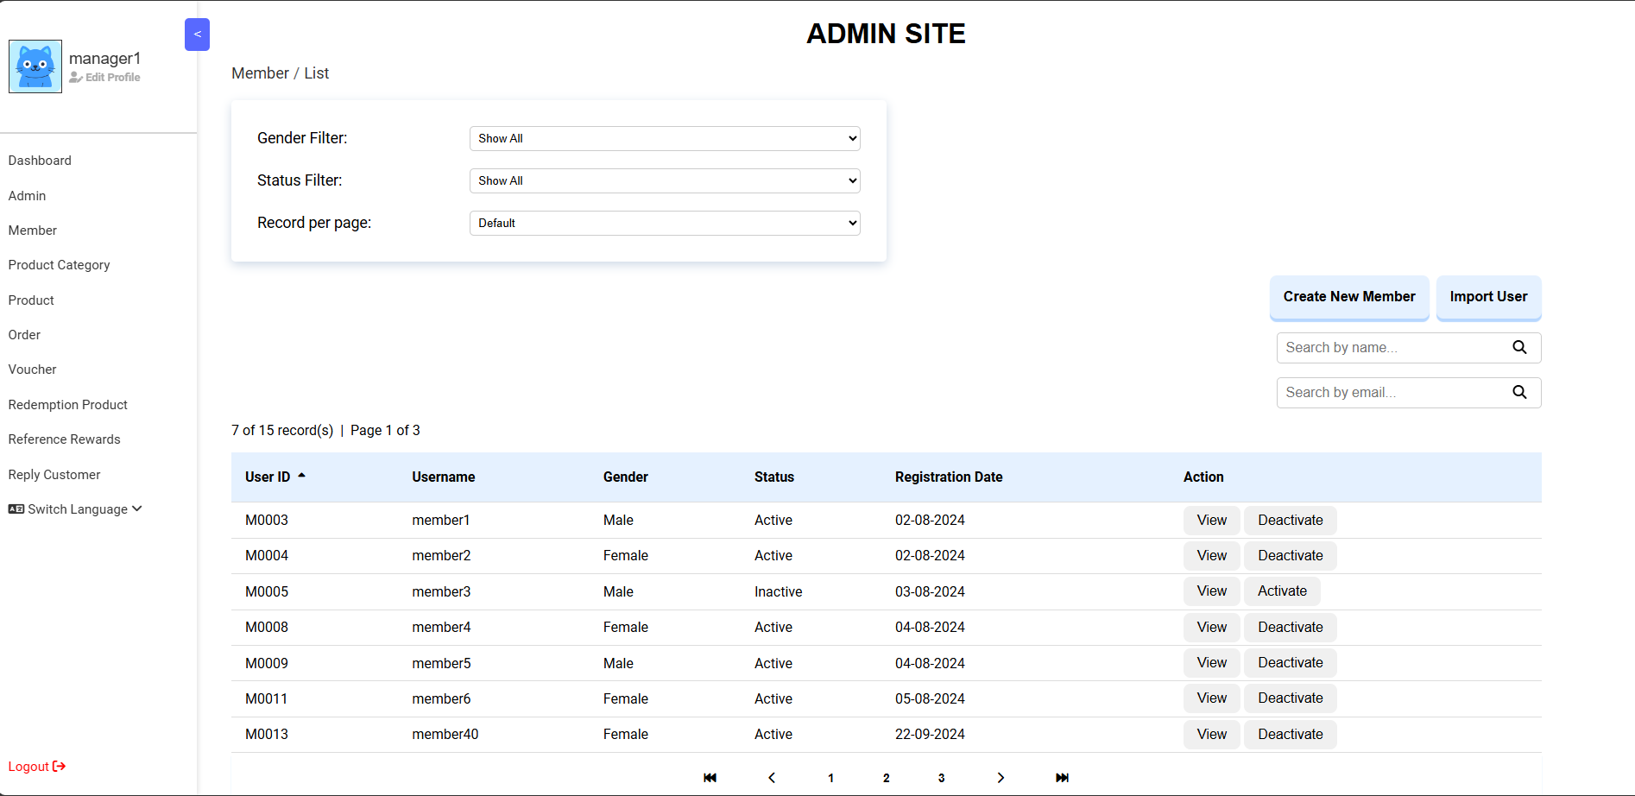
Member List (Admin) Page

Slide 27
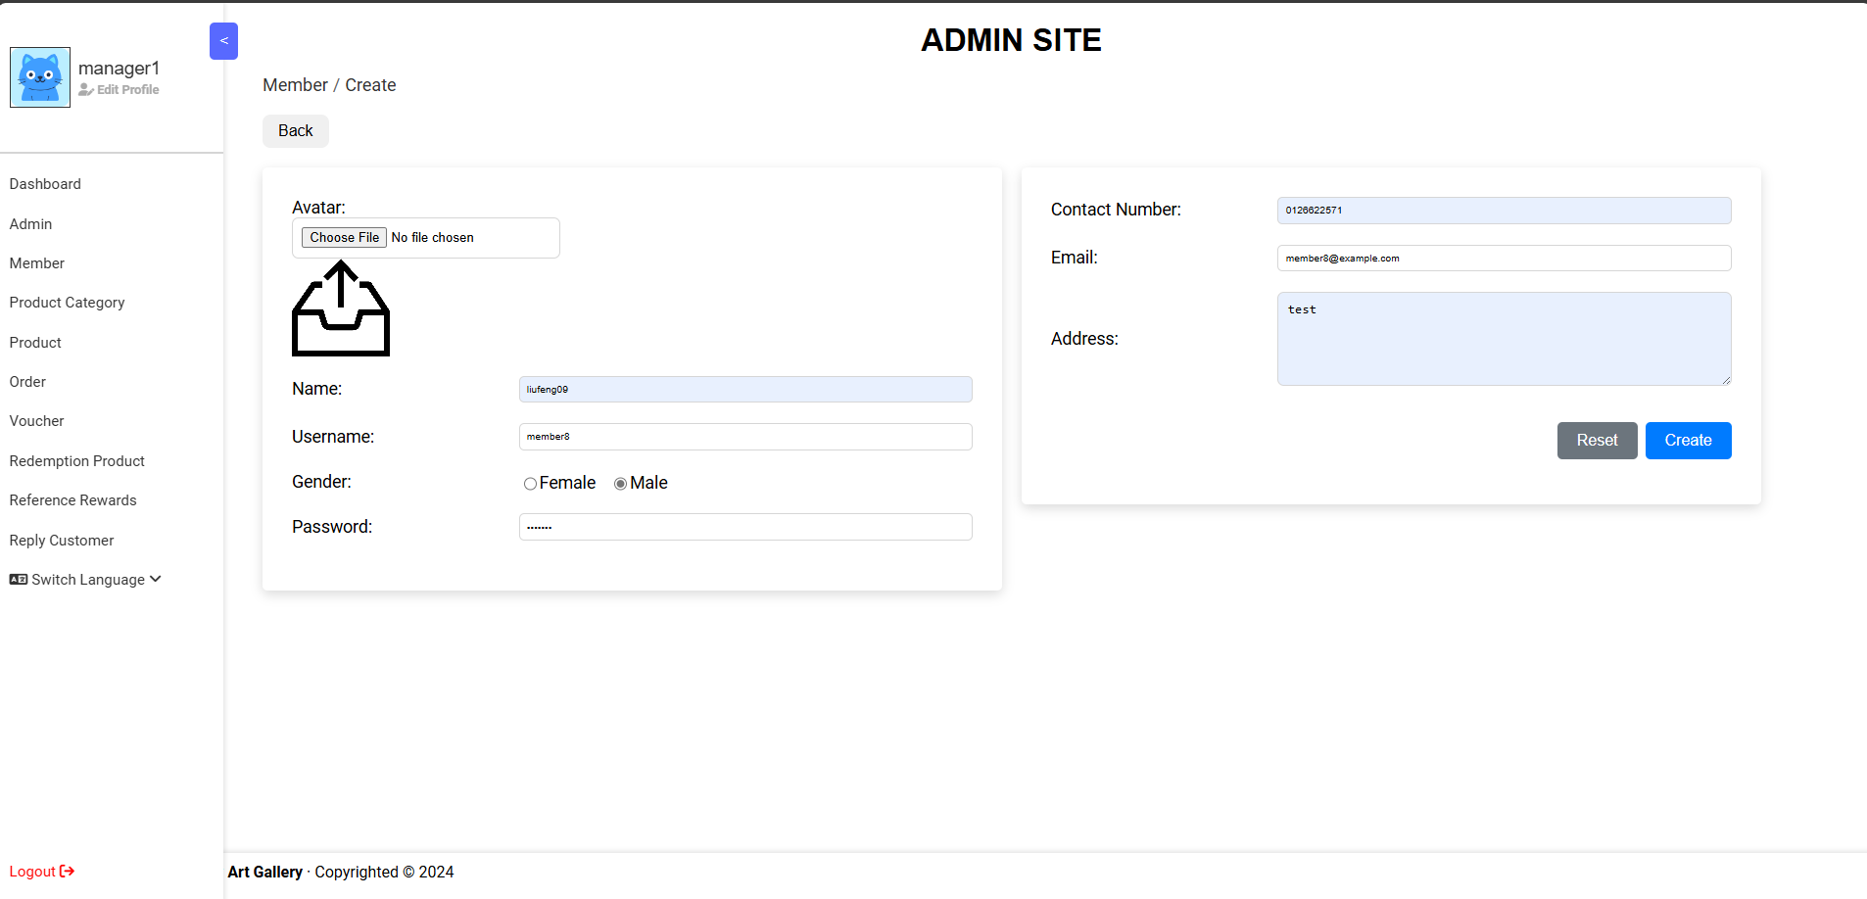
Create Member (Admin) Page

Slide 28
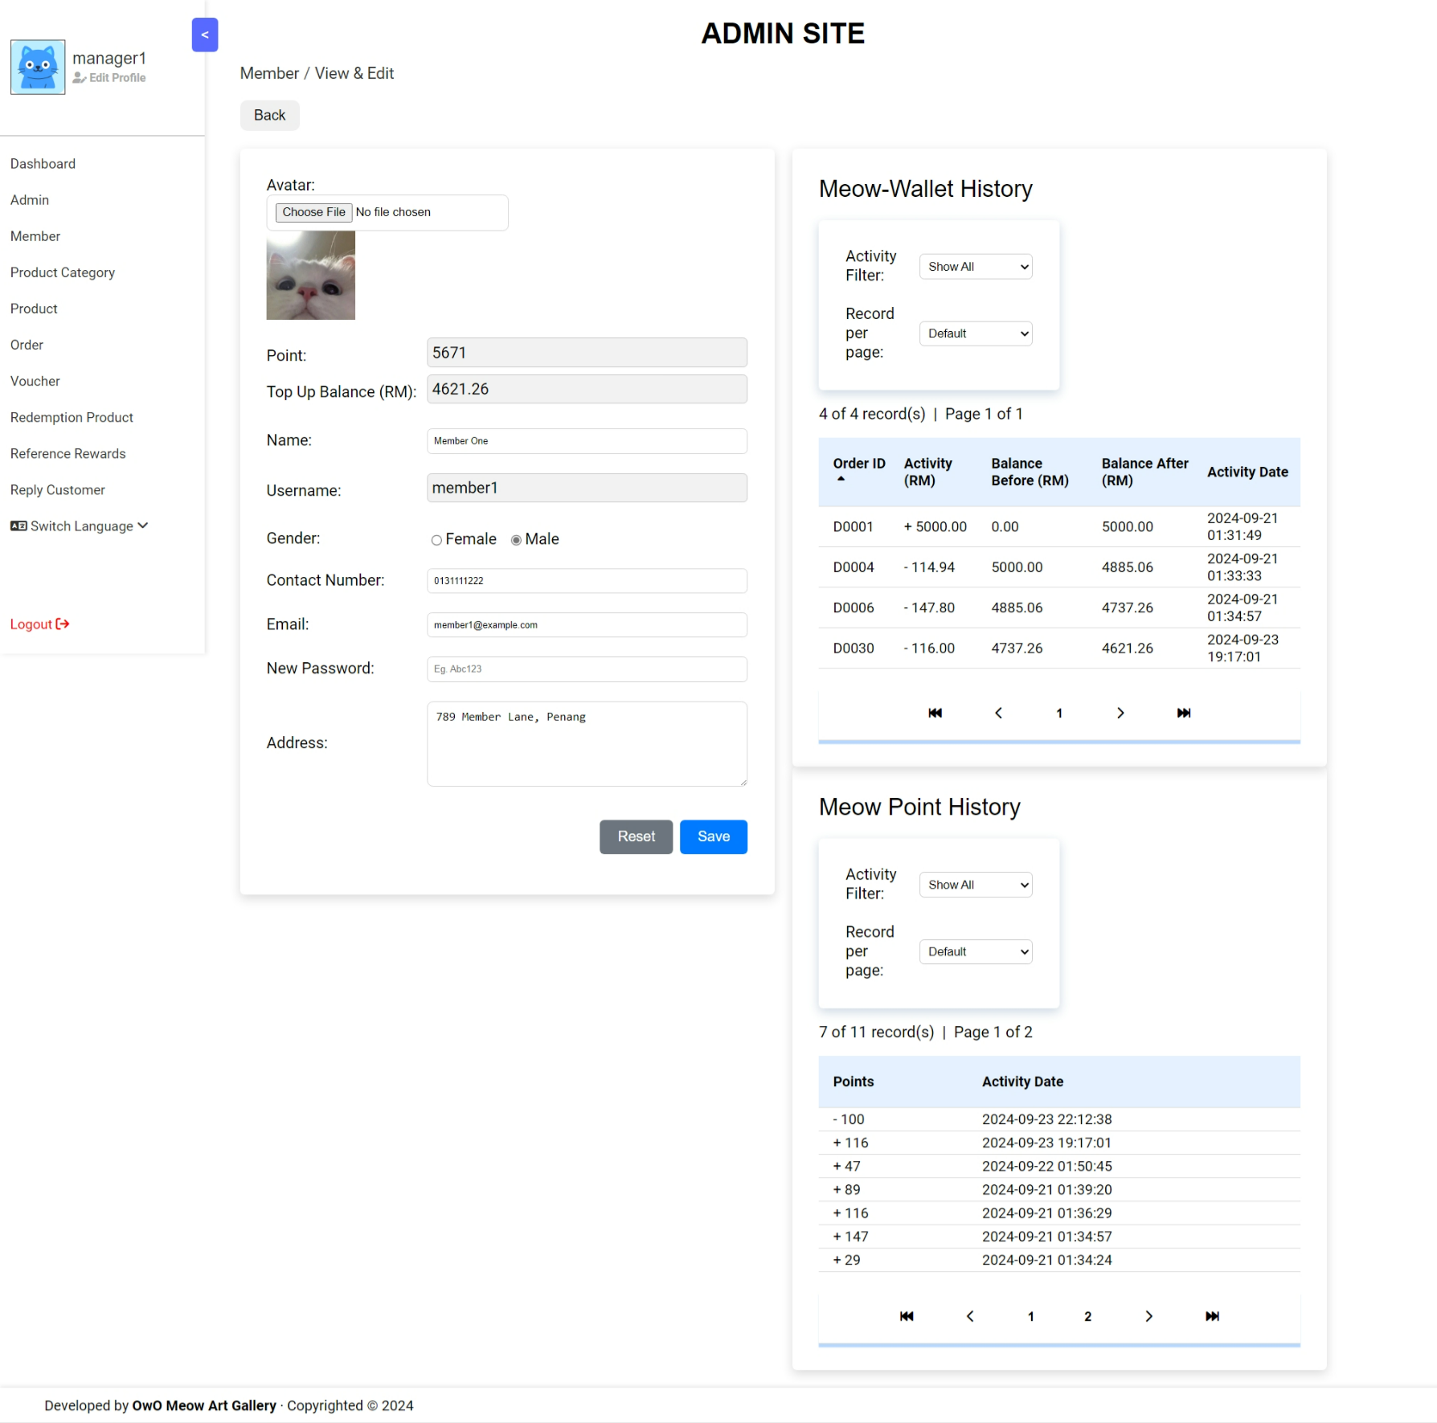
View & Edit Member (Admin) Page [1]

Slide 29
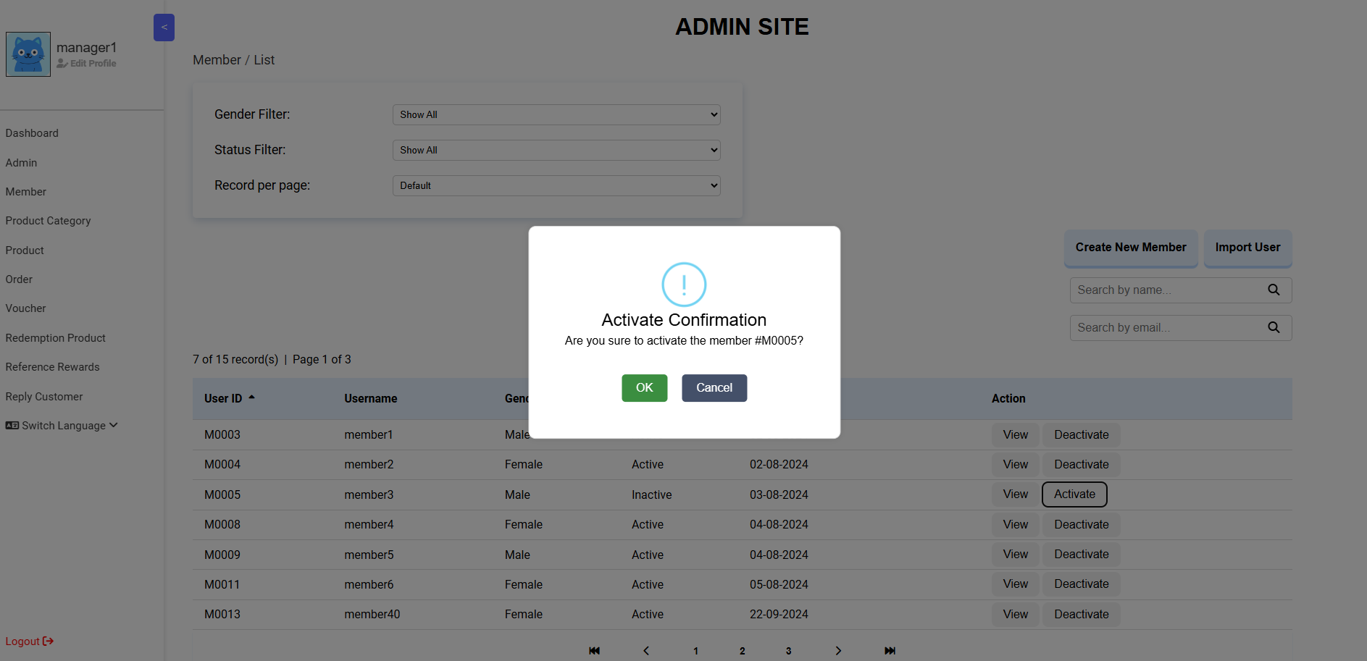
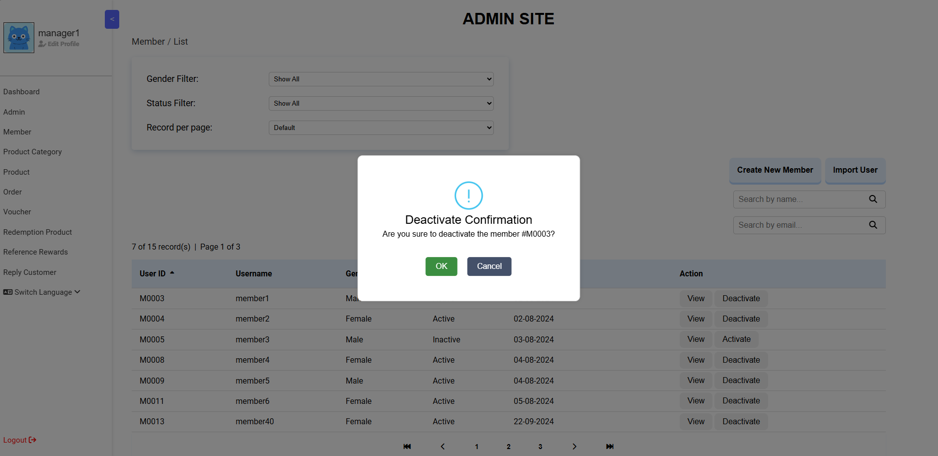
Activate & Deactivate Member (Admin) Page

Slide 30
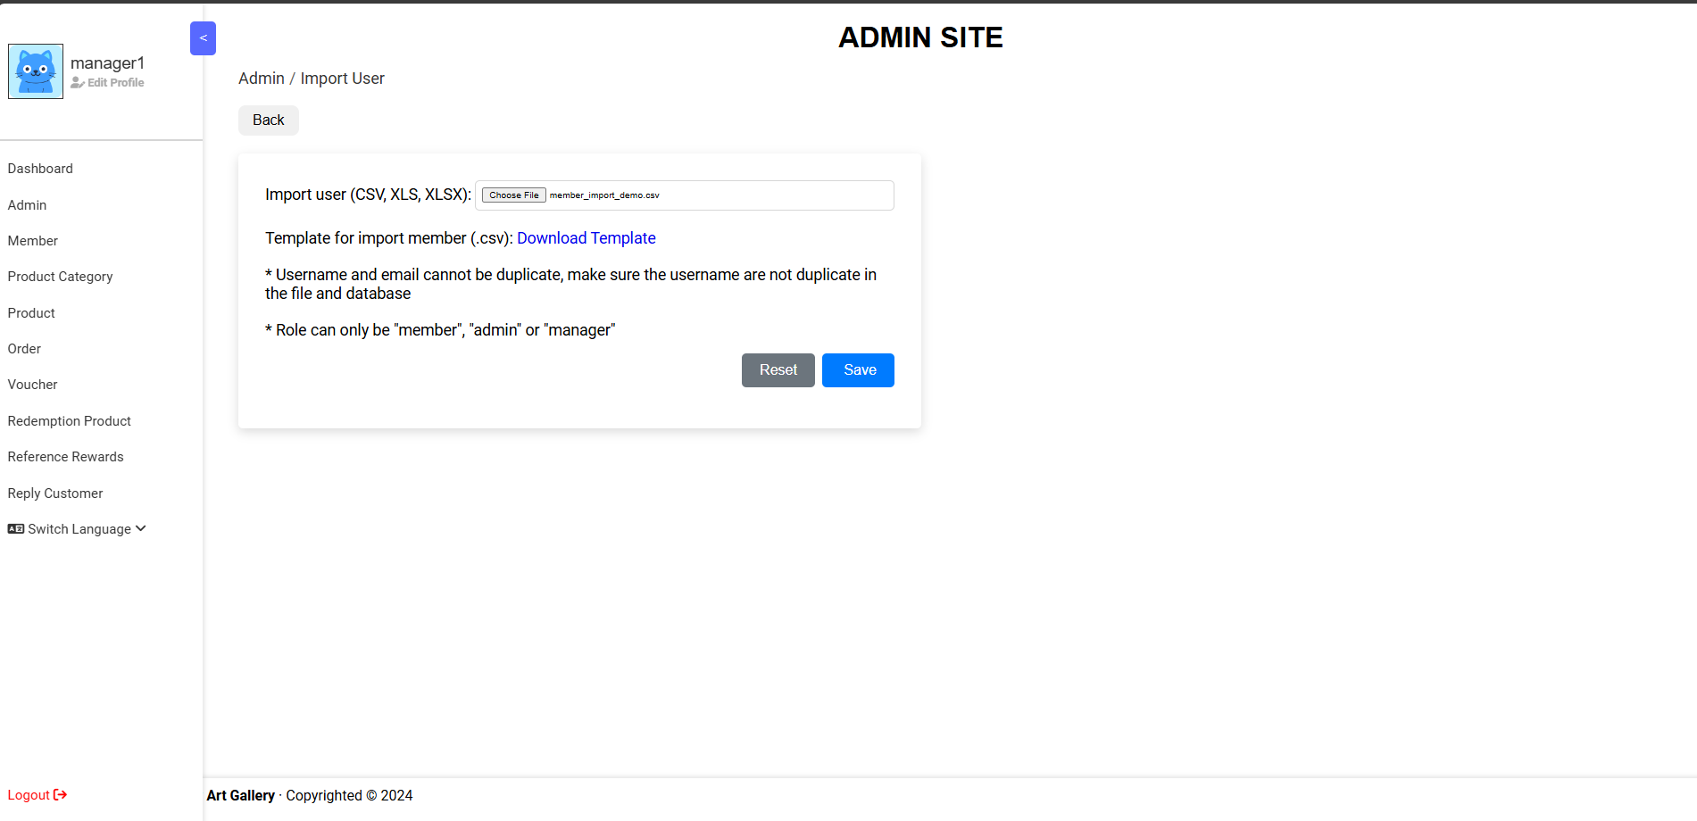
Batch Insert user by CSV(Admin) Page

Slide 31
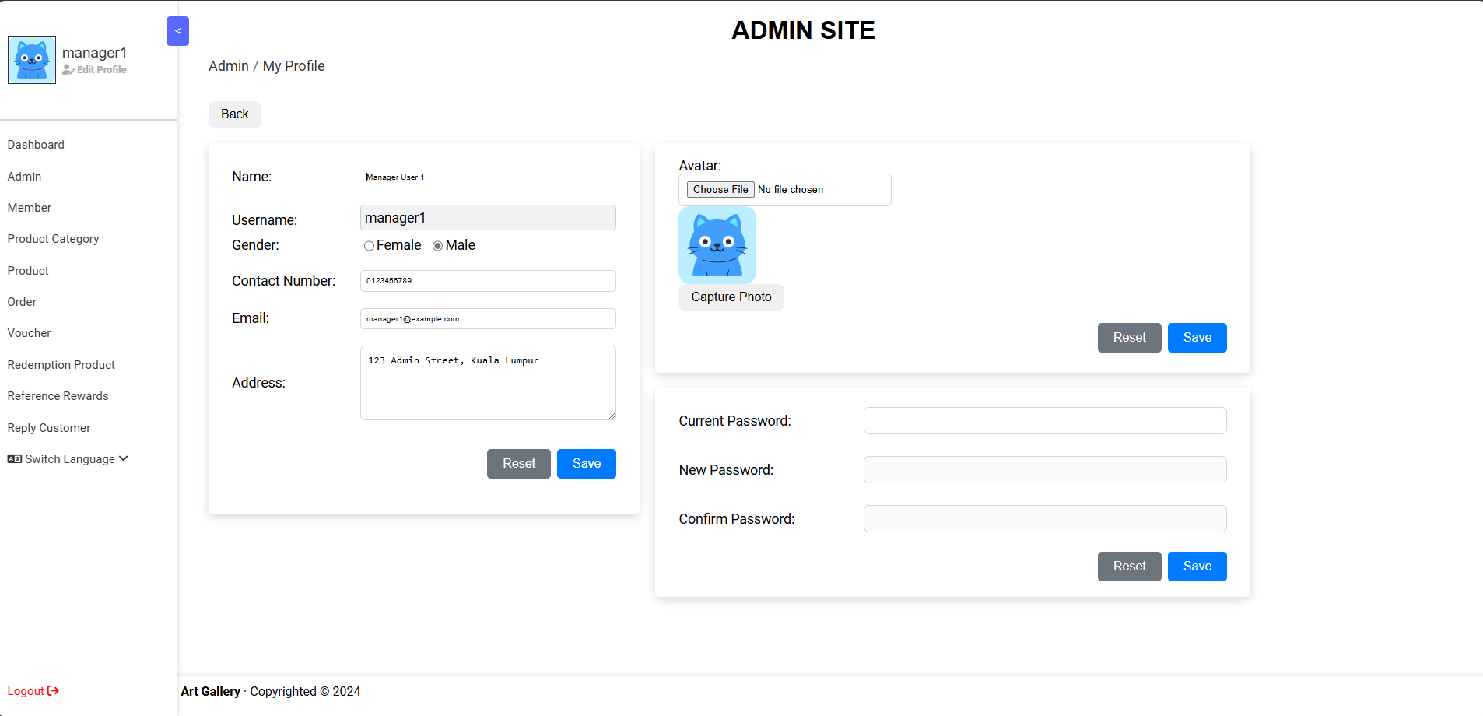
Admin Profile Update Page

Slide 32
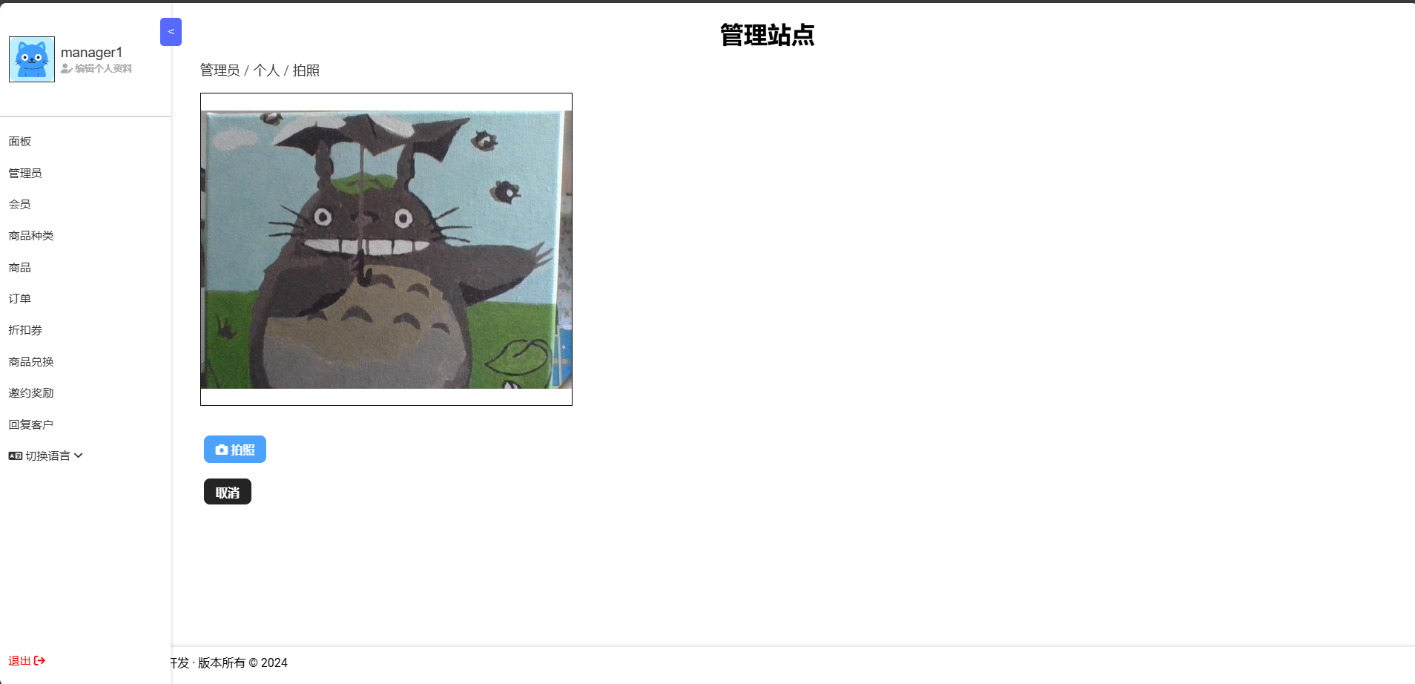
Admin Profile Photo Capture Page

Slide 33
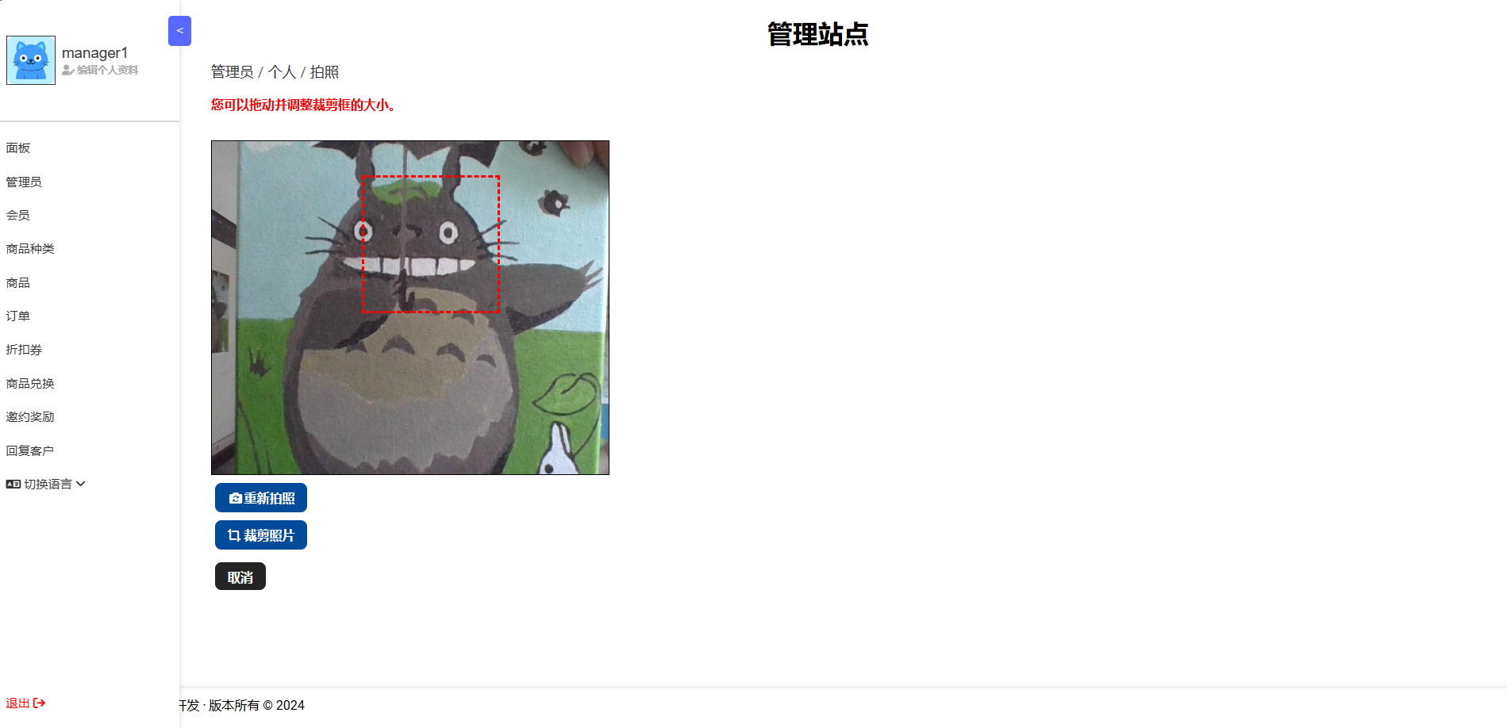
Admin Profile Captured Photo Crop Page

Slide 34
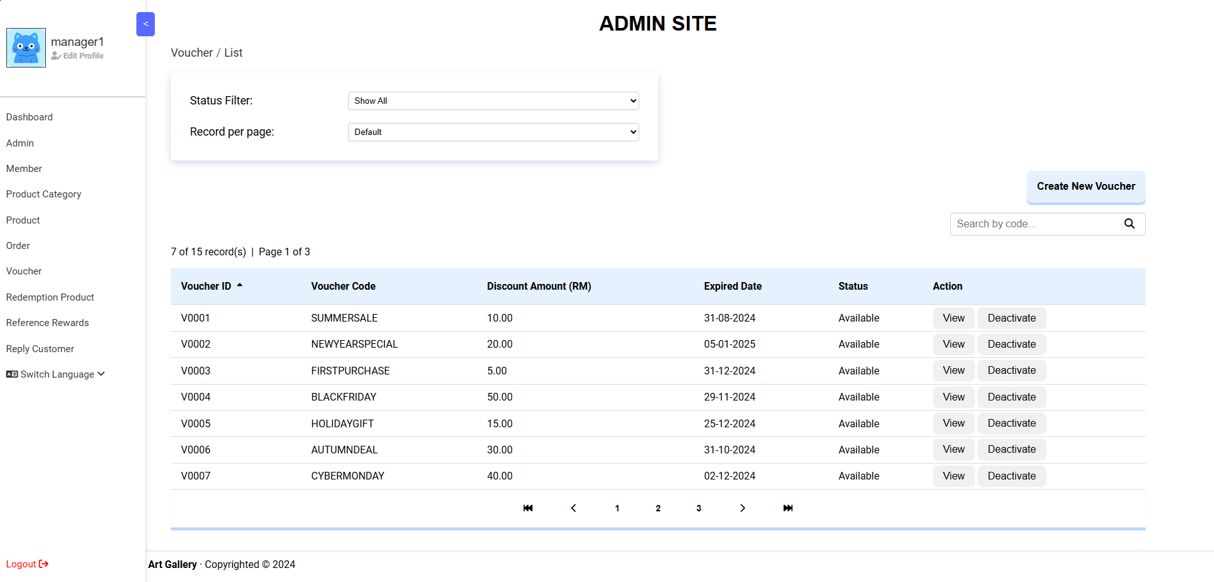
Voucher List (Admin) Page

Slide 35
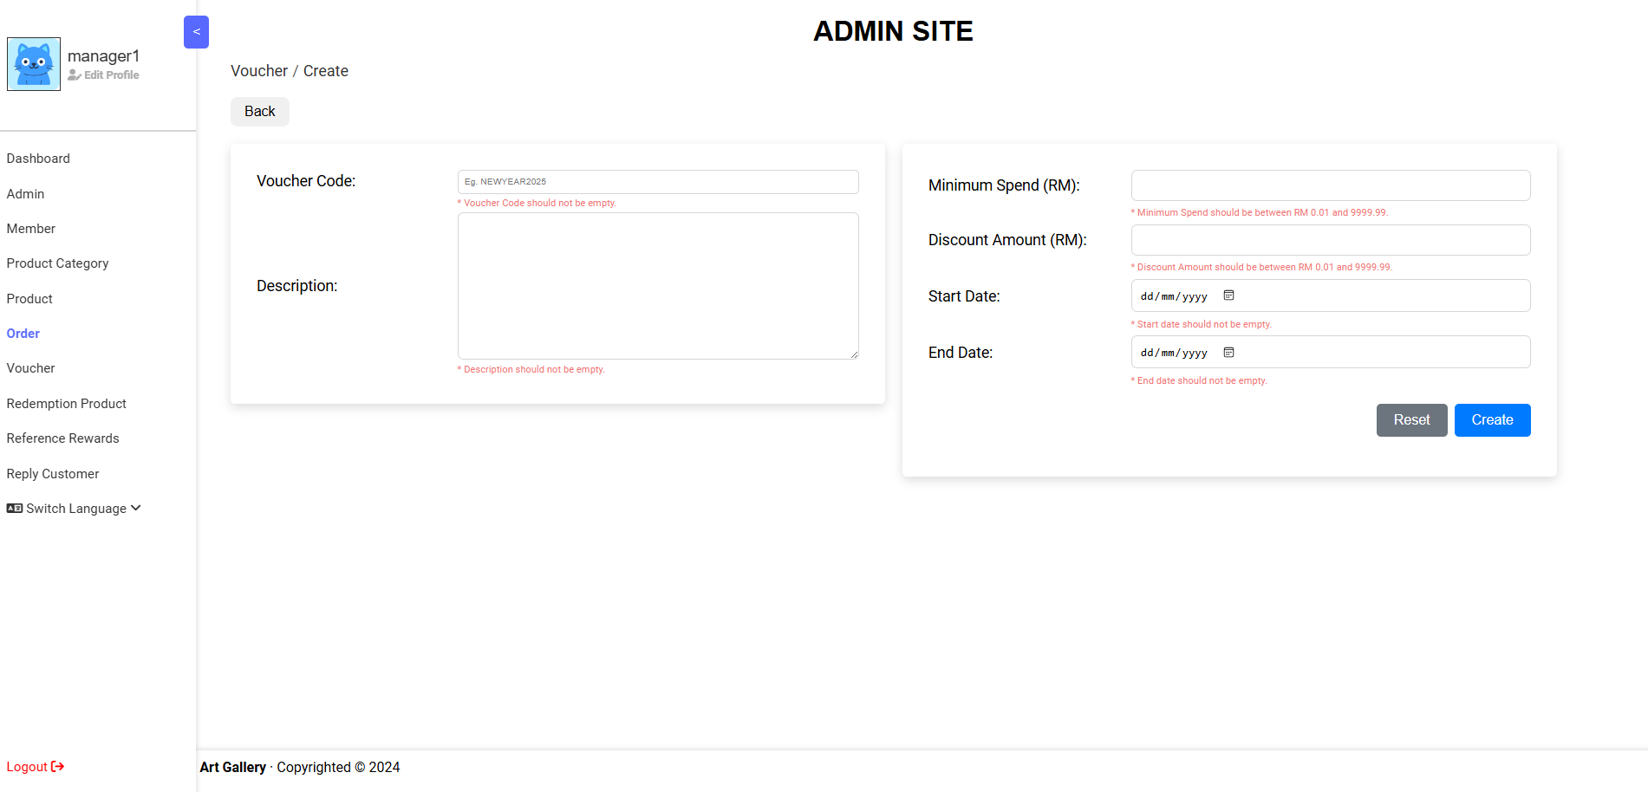
Create Voucher (Admin) Page

Slide 36
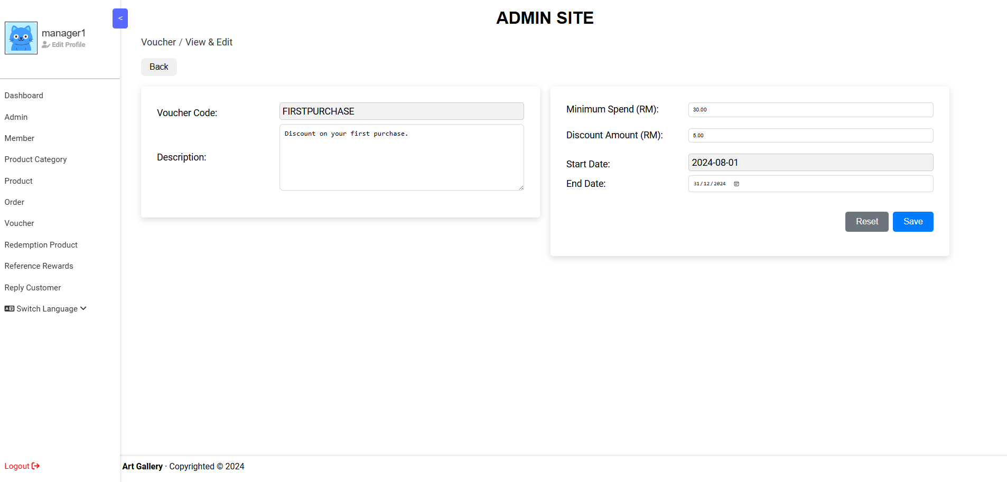
View & Edit Voucher (Admin) Page

Slide 37
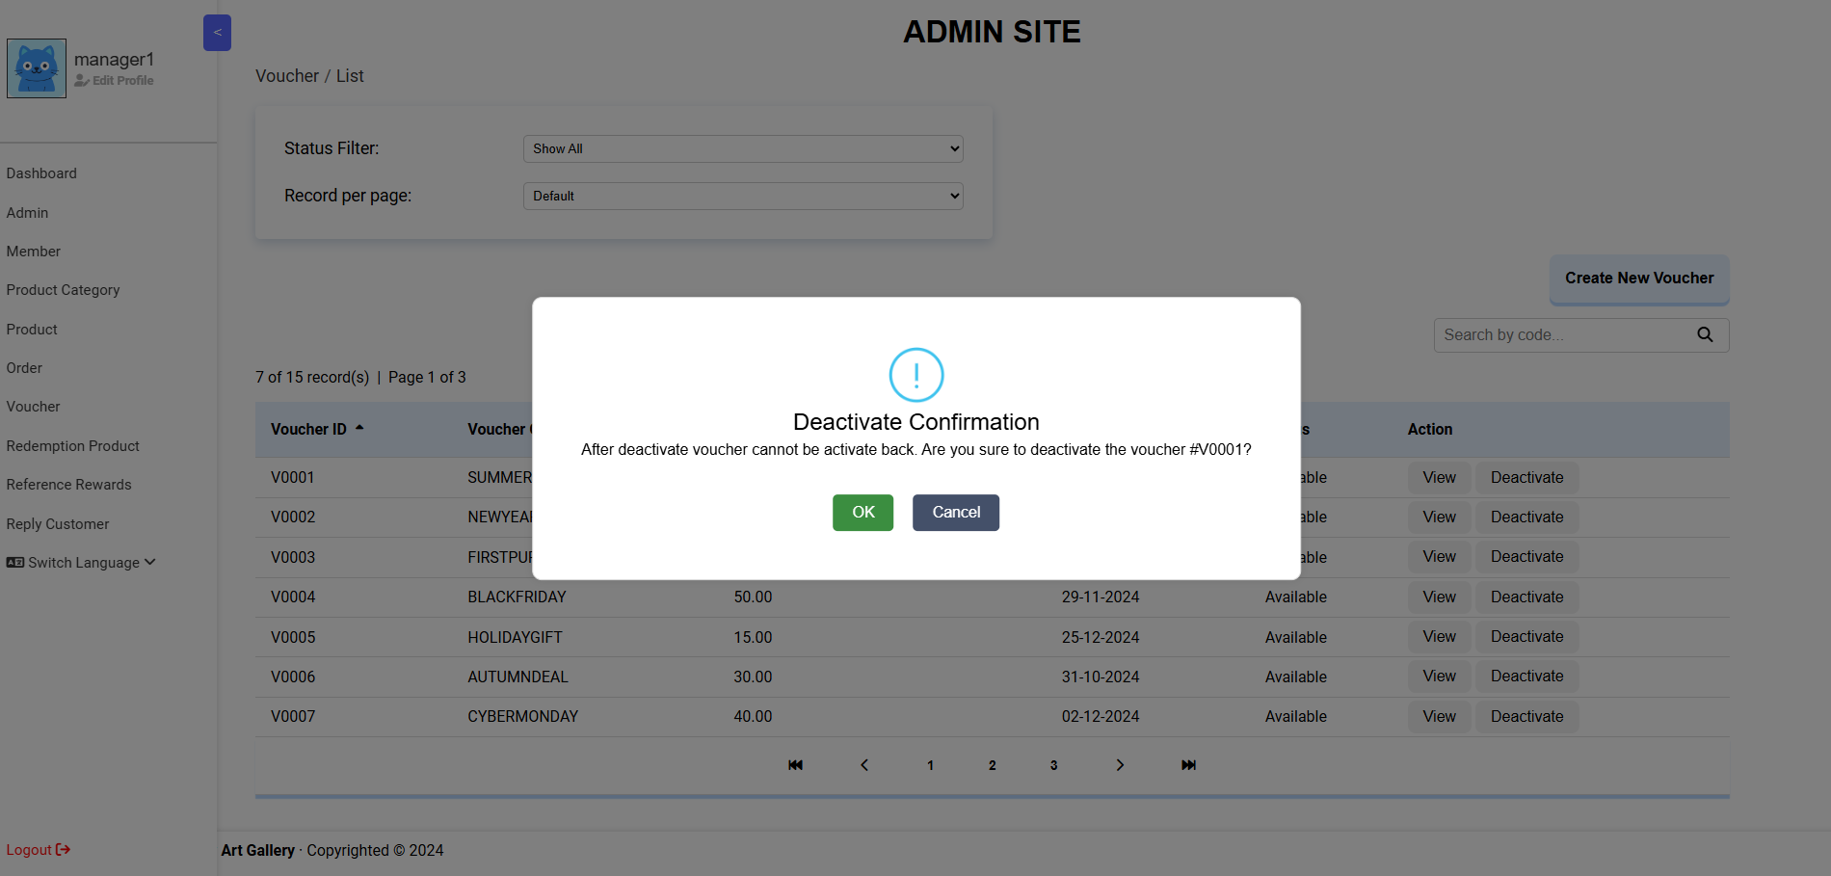
Deactivate Voucher (Admin) Page

Slide 38
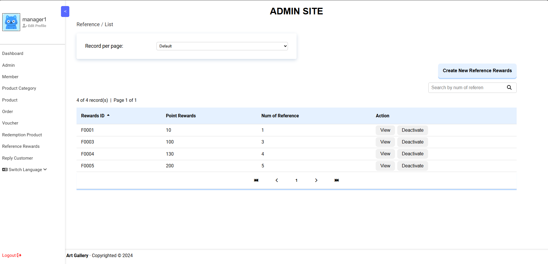
Member Reference Reward List (Admin) Page

Slide 39
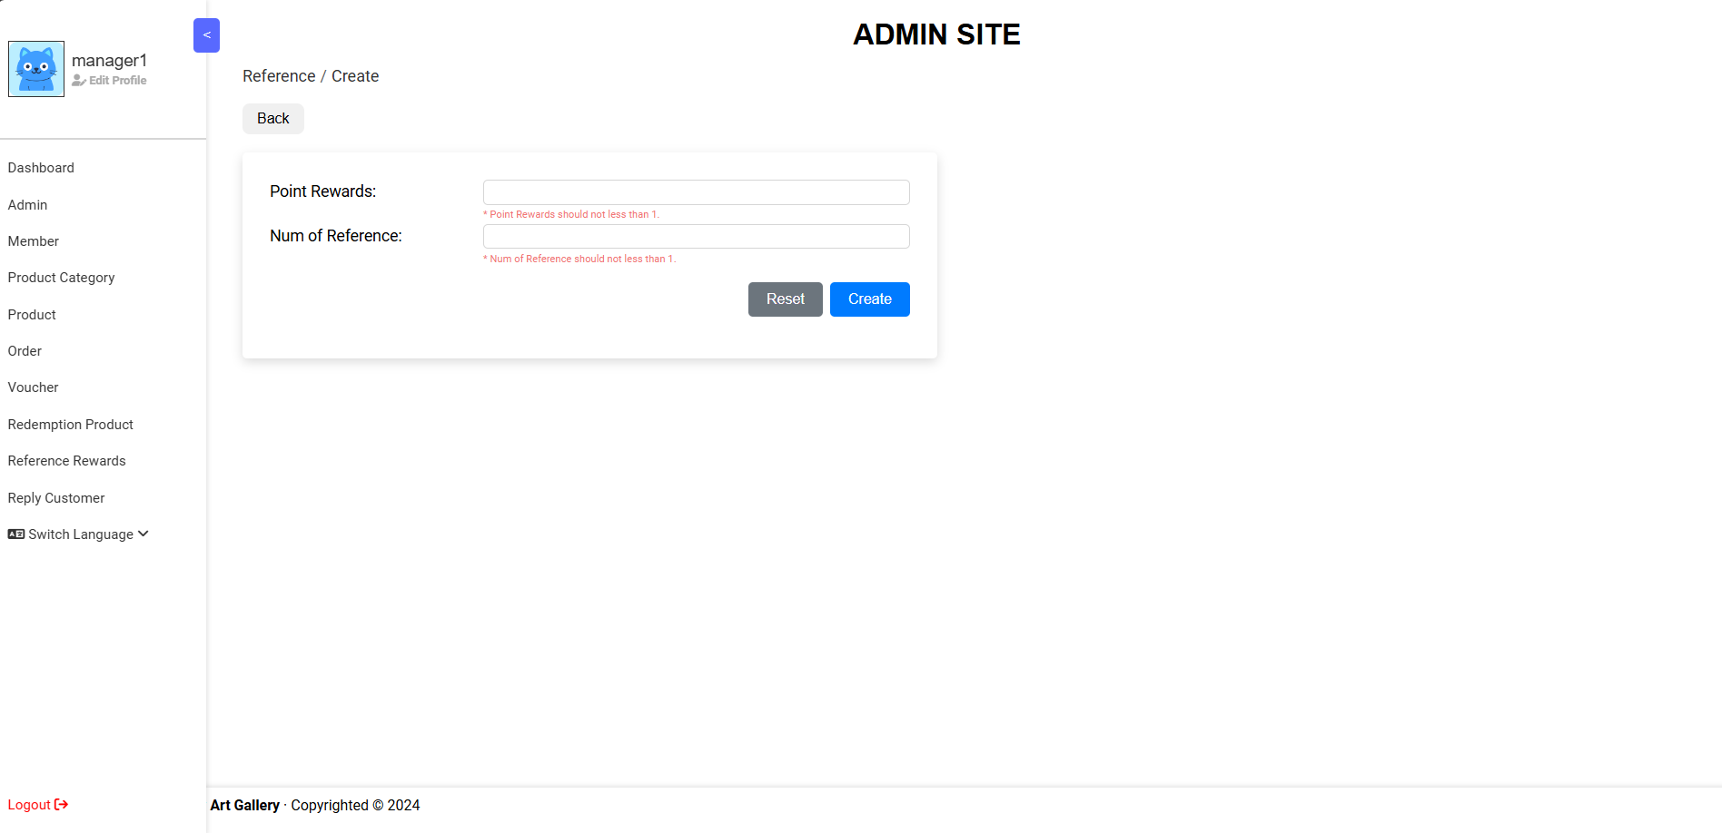
Create Member Reference Reward (Admin) Page

Slide 40
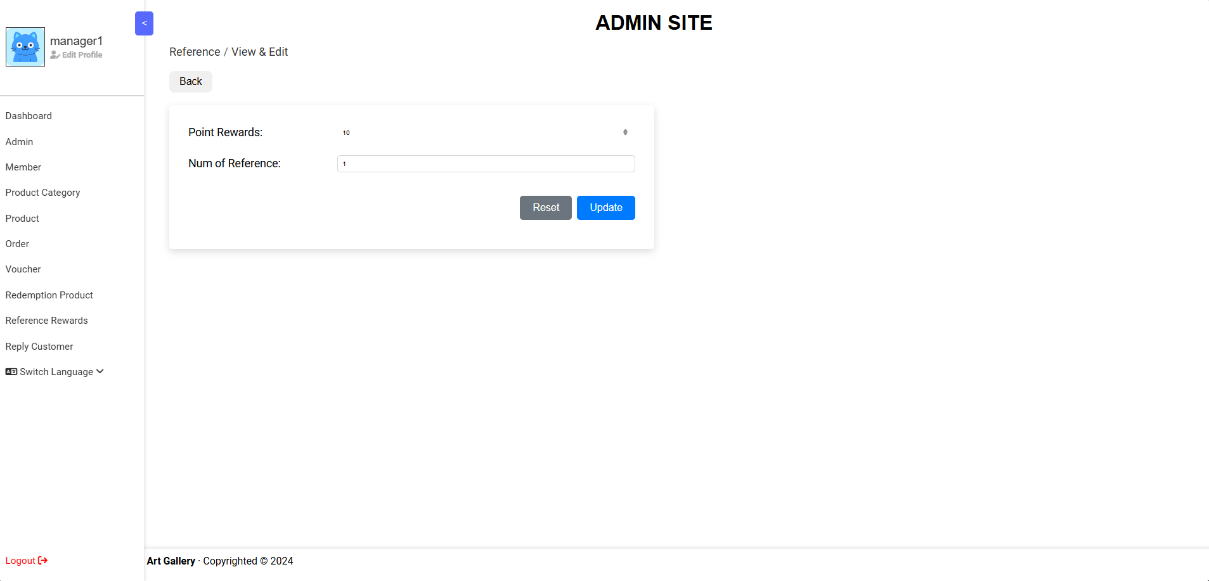
View & Edit Member Reference Reward (Admin) Page

Slide 41
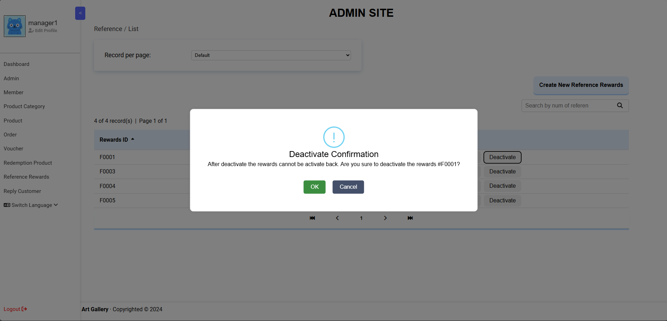
Deactivate Member Reference Reward (Admin) Page

Slide 42
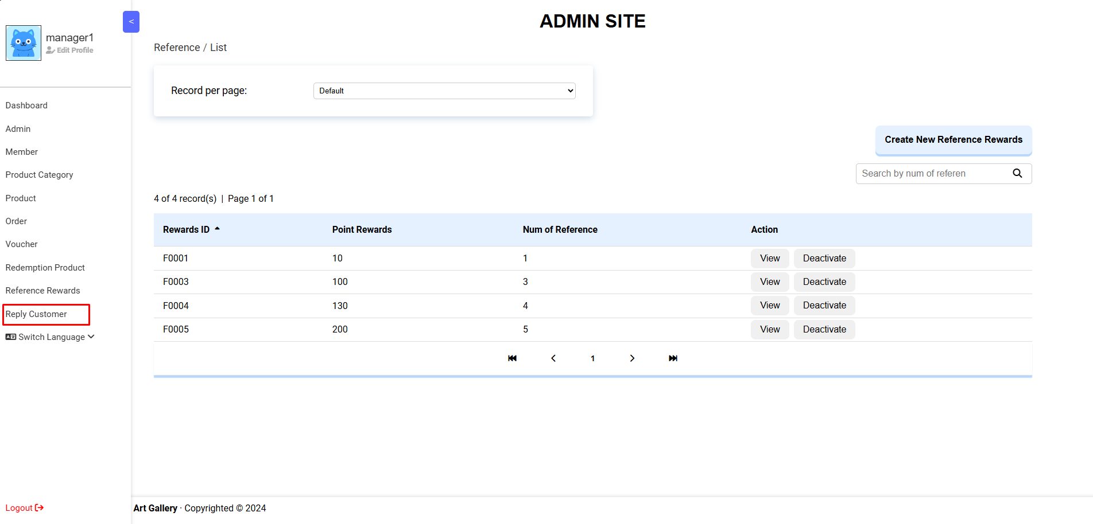
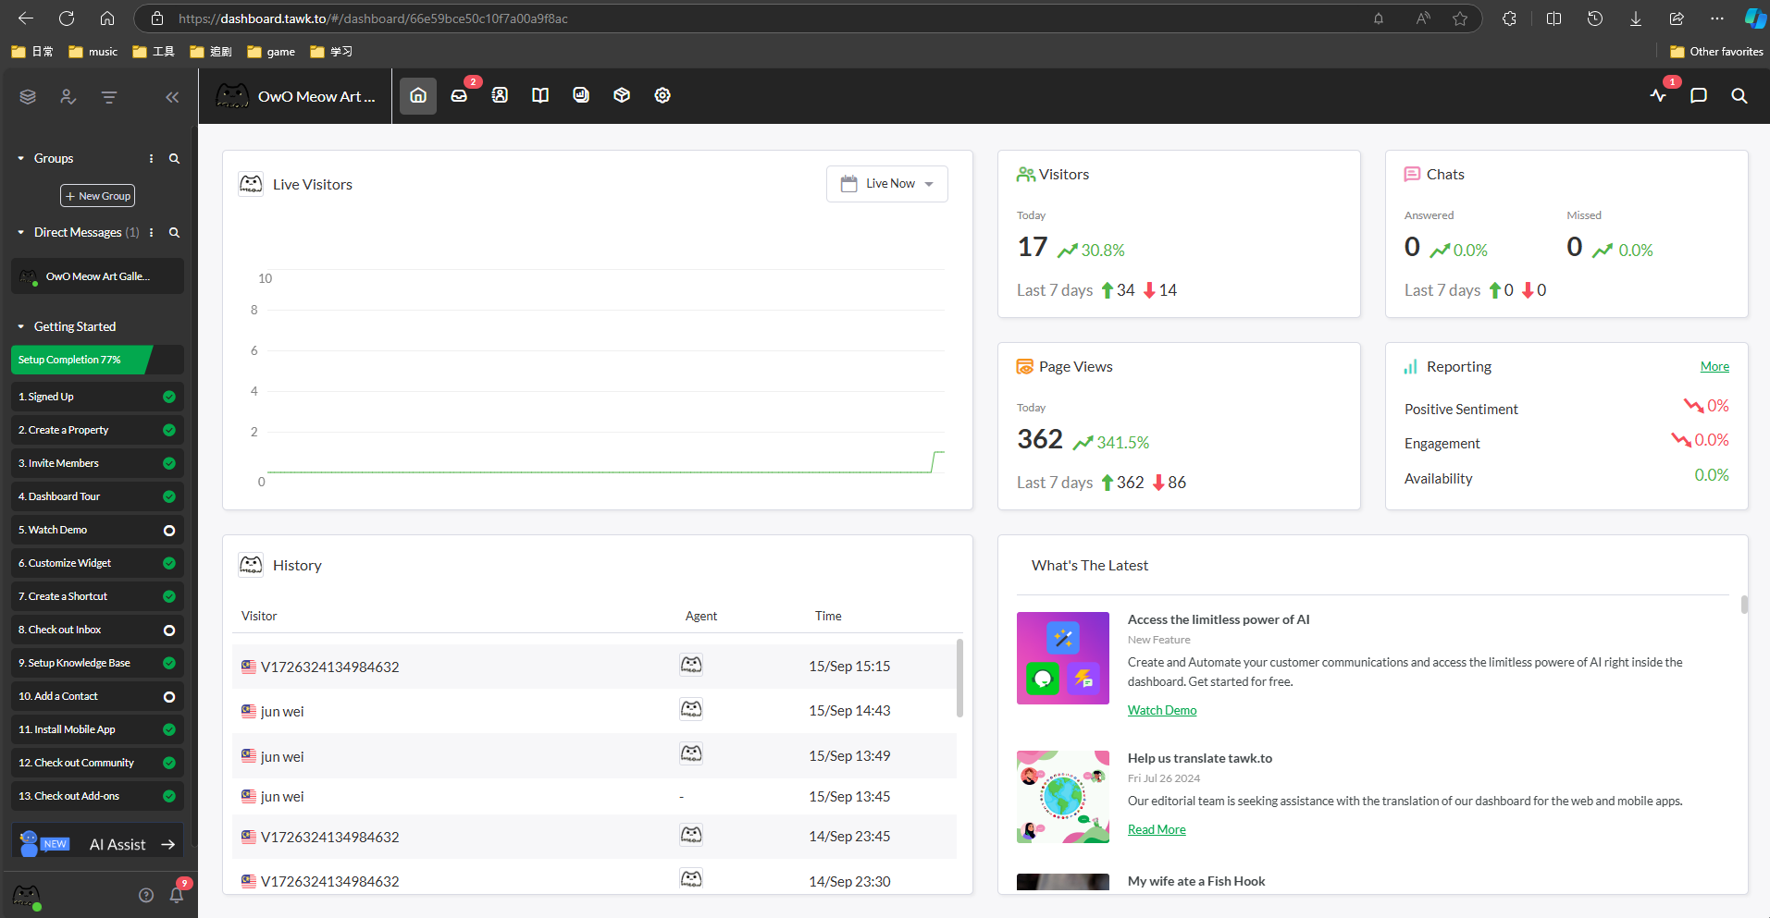
Real-time Chat Manage [tawk.to] (Admin) Page

Slide 43
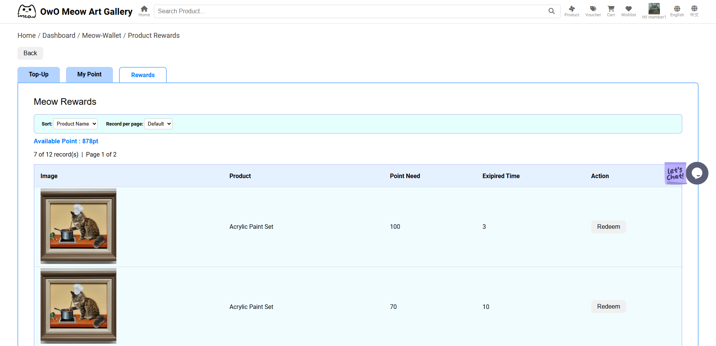
Member Redeem Product Page

Slide 44
Product Redeem List Page

Slide 45
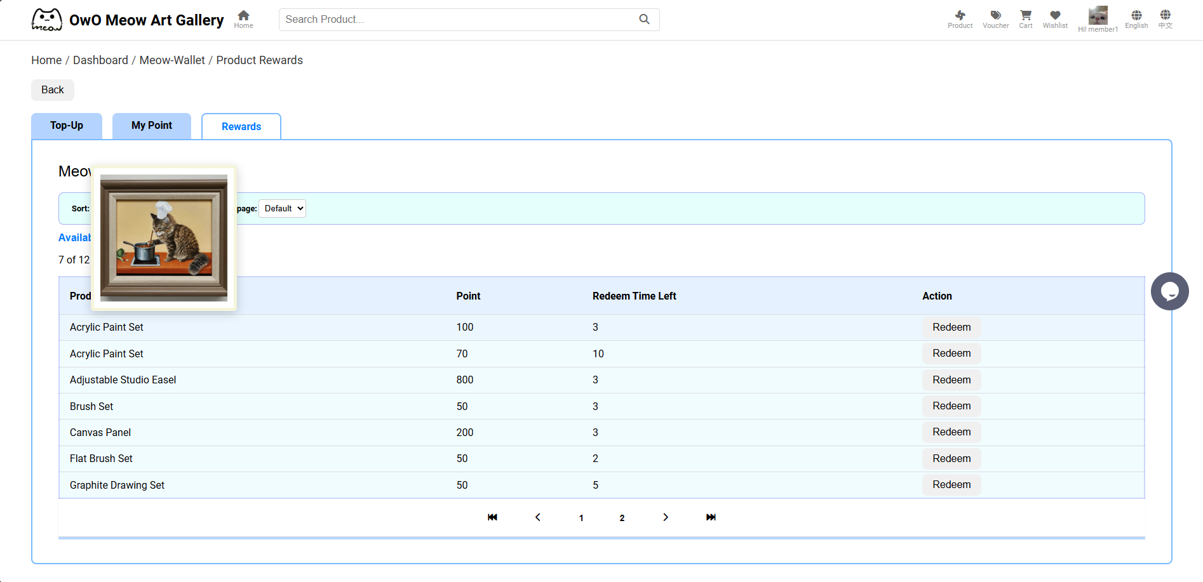
Redeem Product Page

Slide 46
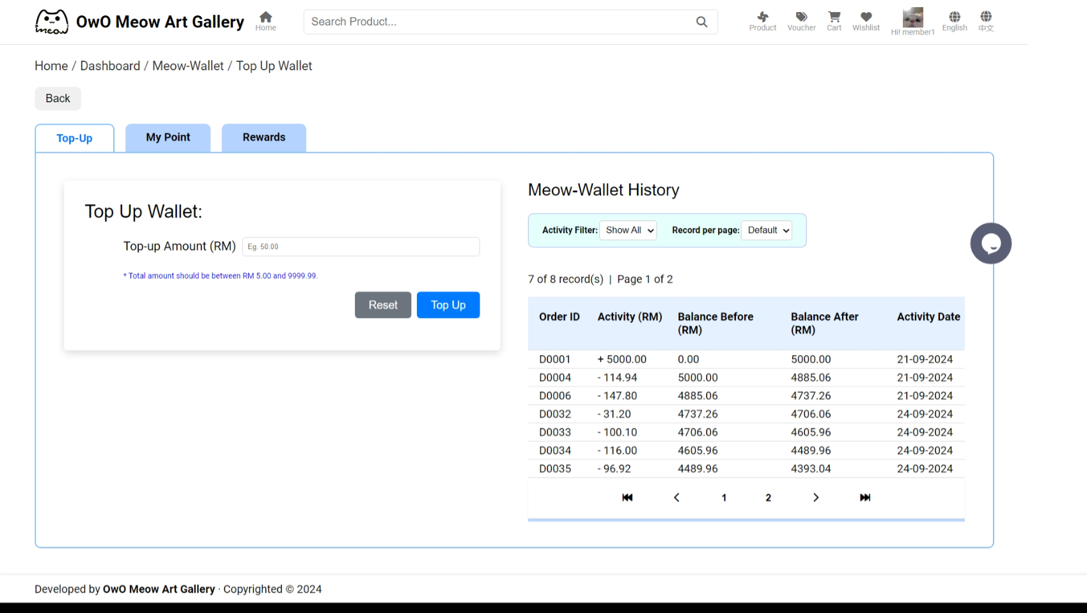
Top Up & Top Up History Page

Slide 47
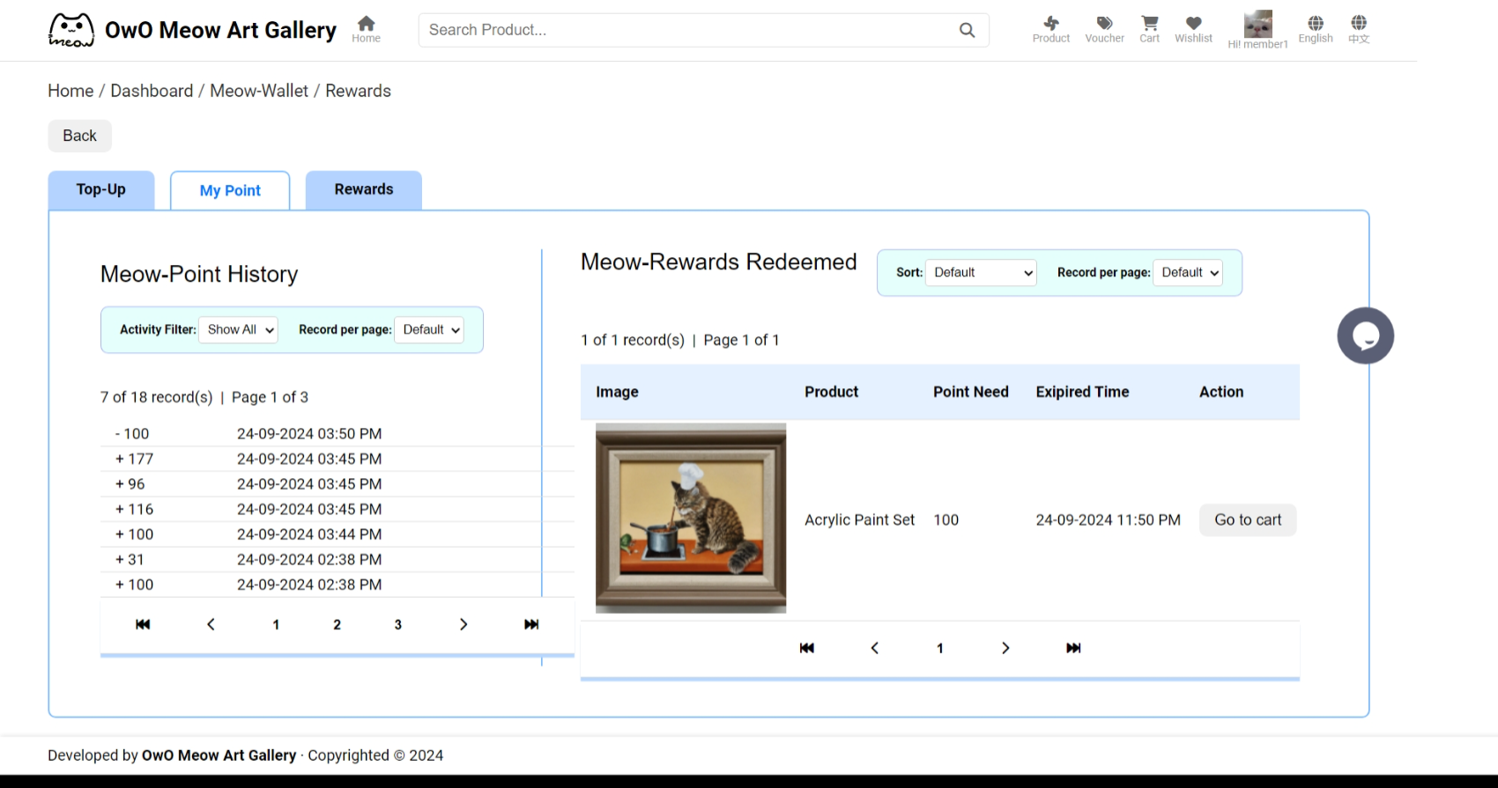
Point History & Product Redeemed Page

Slide 48
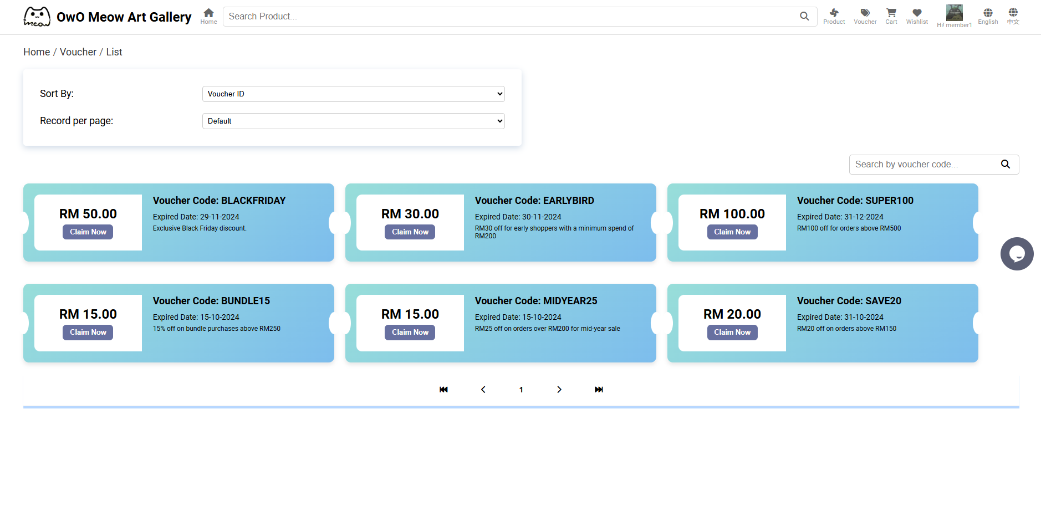
Voucher List & Claim Voucher (Member) Page

Slide 49
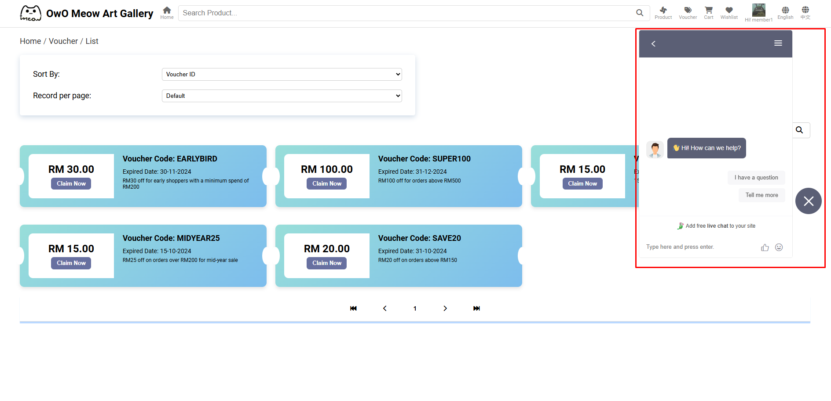
Real-time Chat (Member) Page

Slide 50
3. Lim Jun Wei

Slide 51
3. Lim Jun Wei
Admin & Manager Maintenance
View admin listing
Update admin details
Deactivate admin
Drag-and-Drop Photo Upload
Filter, sorting, paging and searching
AJAX Integration on refreshing list
Order Maintenance
View order listing
Order Status Update
Send email (order status update)
Filter, sorting, paging and searching
AJAX Integration on refreshing list
View order receipt PDF

Slide 52
3. Lim Jun Wei
Member Site Product
Product listing
Filter, sorting, paging and searching
Product images slider
Member Site Product Review
Upload product review and rating
Product review and rating listing
Filter, sorting and paging
Upload multiple images for one review
Member Site Wishlist
Wishlist listing
Add product to wishlist
Remove product from wishlist
Filter, sorting and paging
Bilingual Support
English & Chinese (Admin)

Slide 53
3. Lim Jun Wei
Shopping Cart
Add product to cart
Permanent shopping cart
Update cart product detail
Batch insert product to wishlist
Batch remove product from cart
AJAX integration in refreshing cart details, vouchers and product redemption
Checkout + Create Order
Payment
Integrate Stripe API which supports card payment)
E-wallet support (fake data entry, using own database)
Meow Wallet (using top-up credit)
Send payment success and e-receipt email

Slide 54
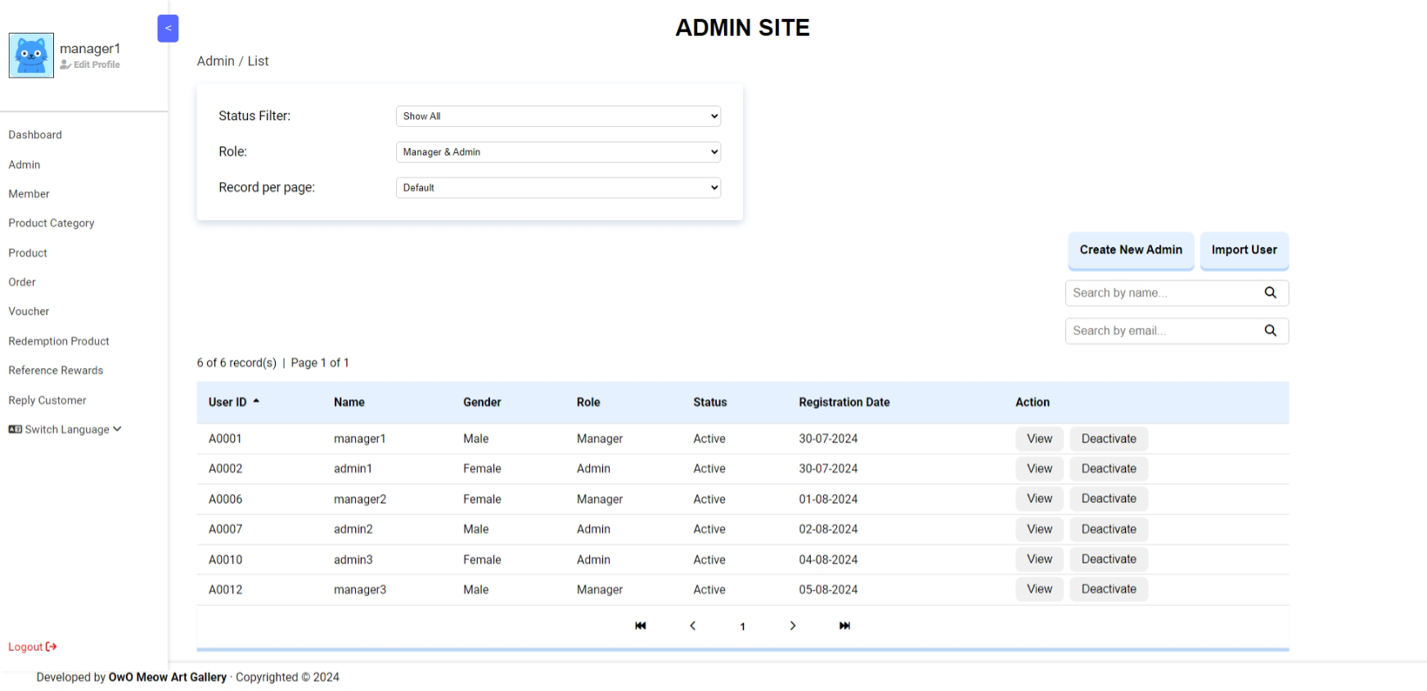
Admin & Manager Maintenance

Slide 55
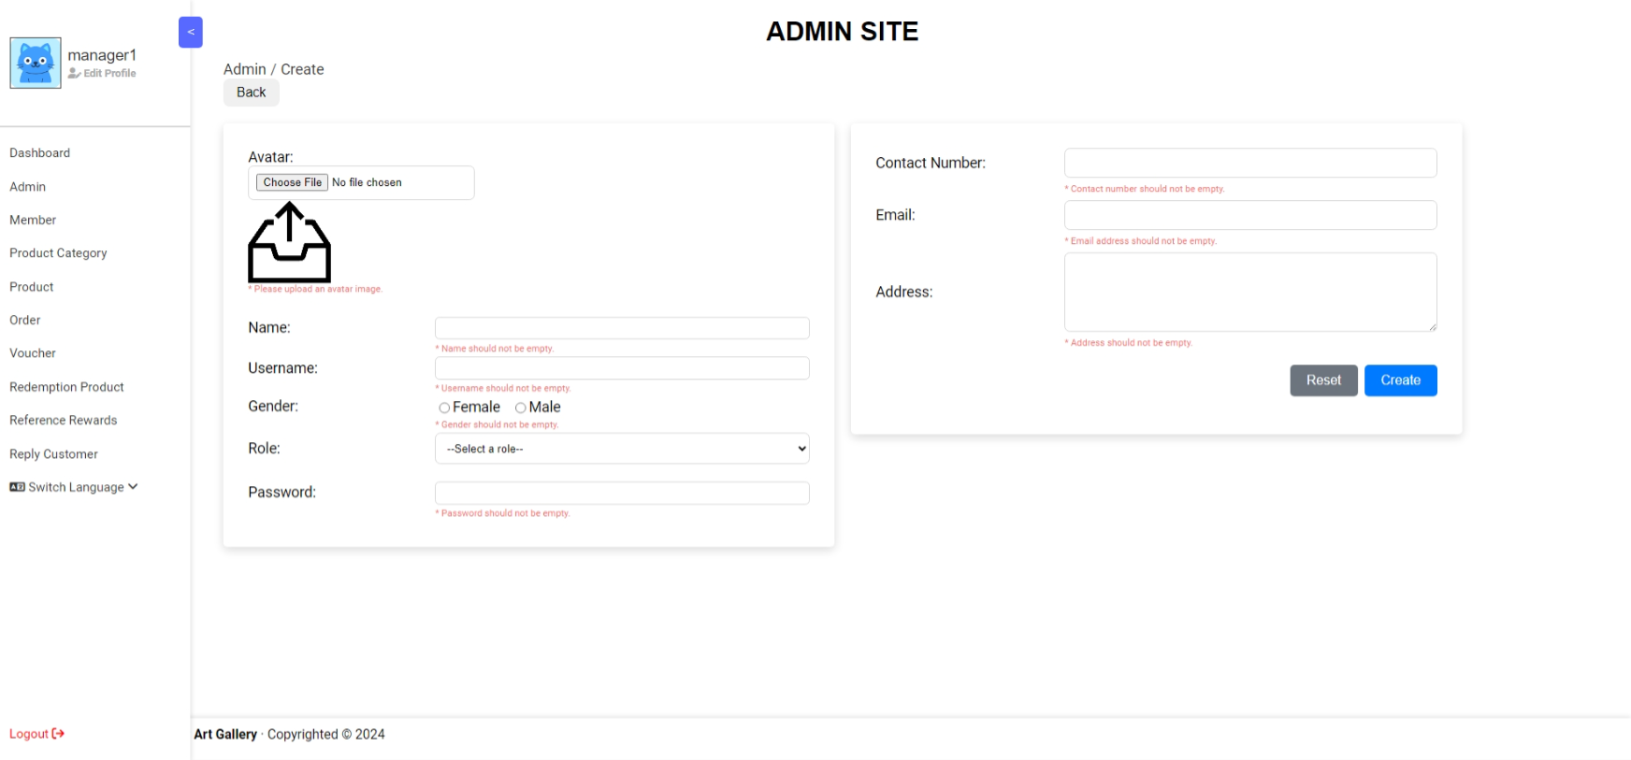
Create New Admin & Manager

Slide 56
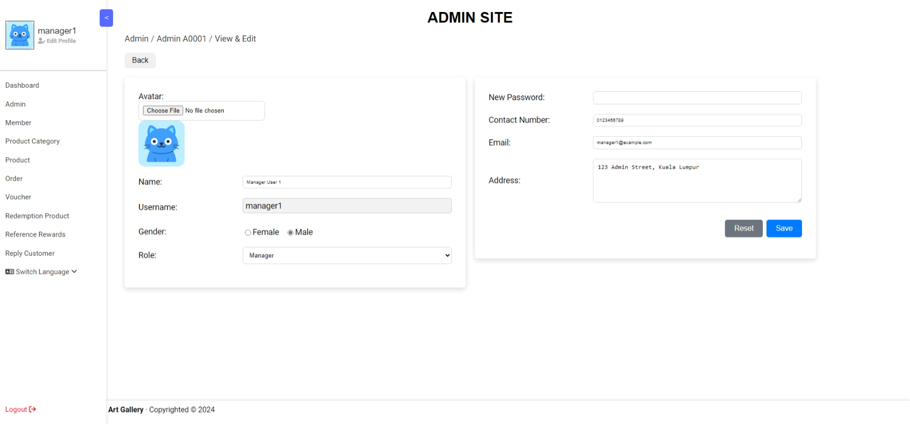
Edit Existing Admin & Manager

Slide 57
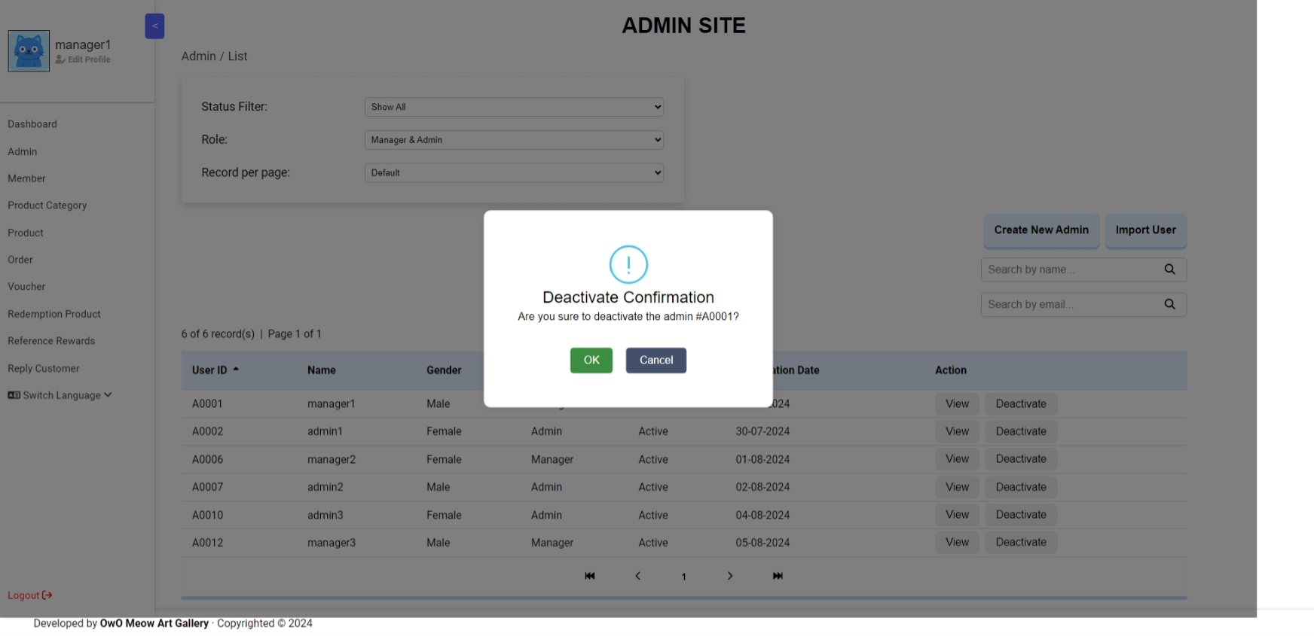
Deactivate Admin & Manager

Slide 58
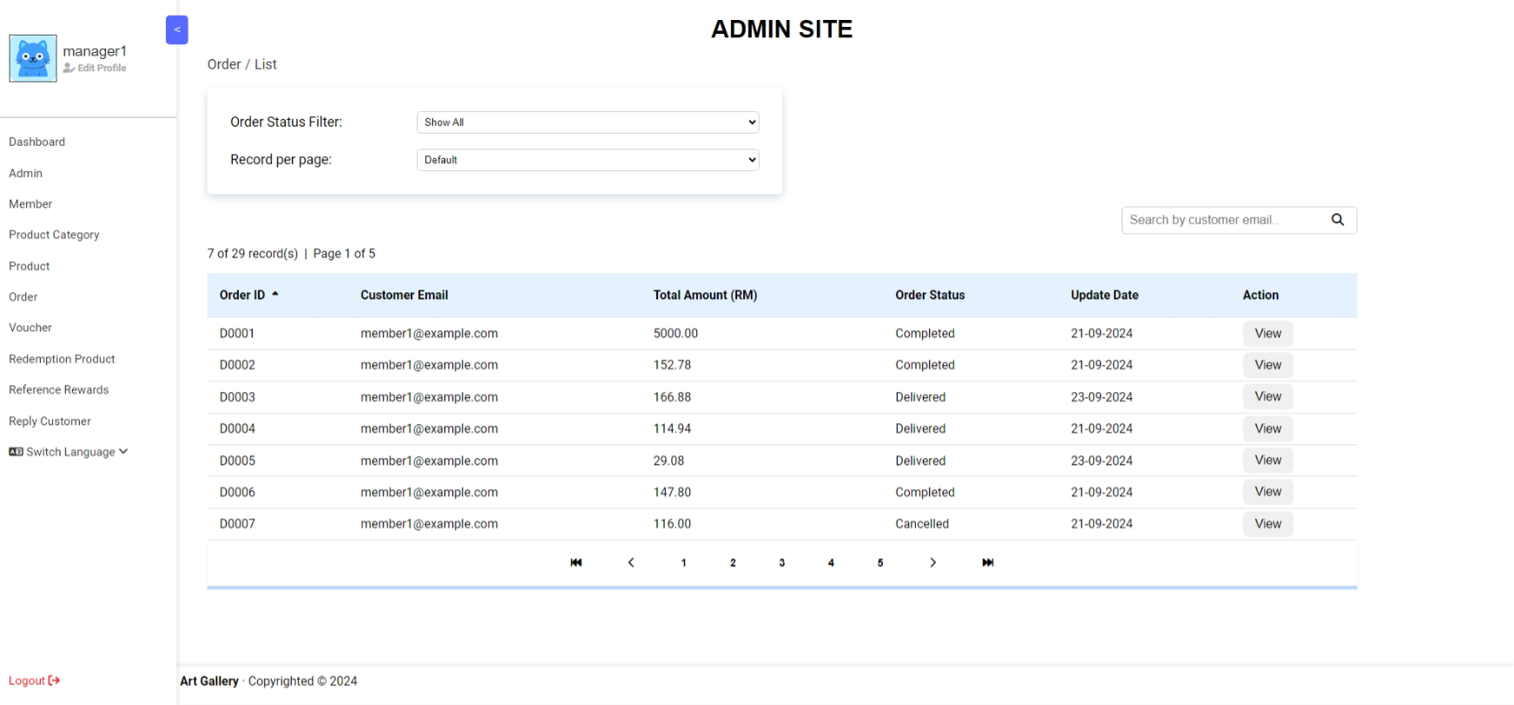
Order Maintenance

Slide 59
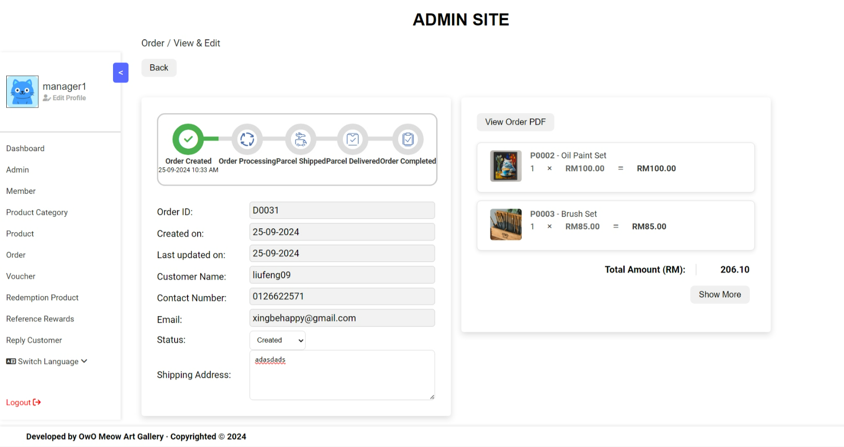
View Order Detail

Slide 60
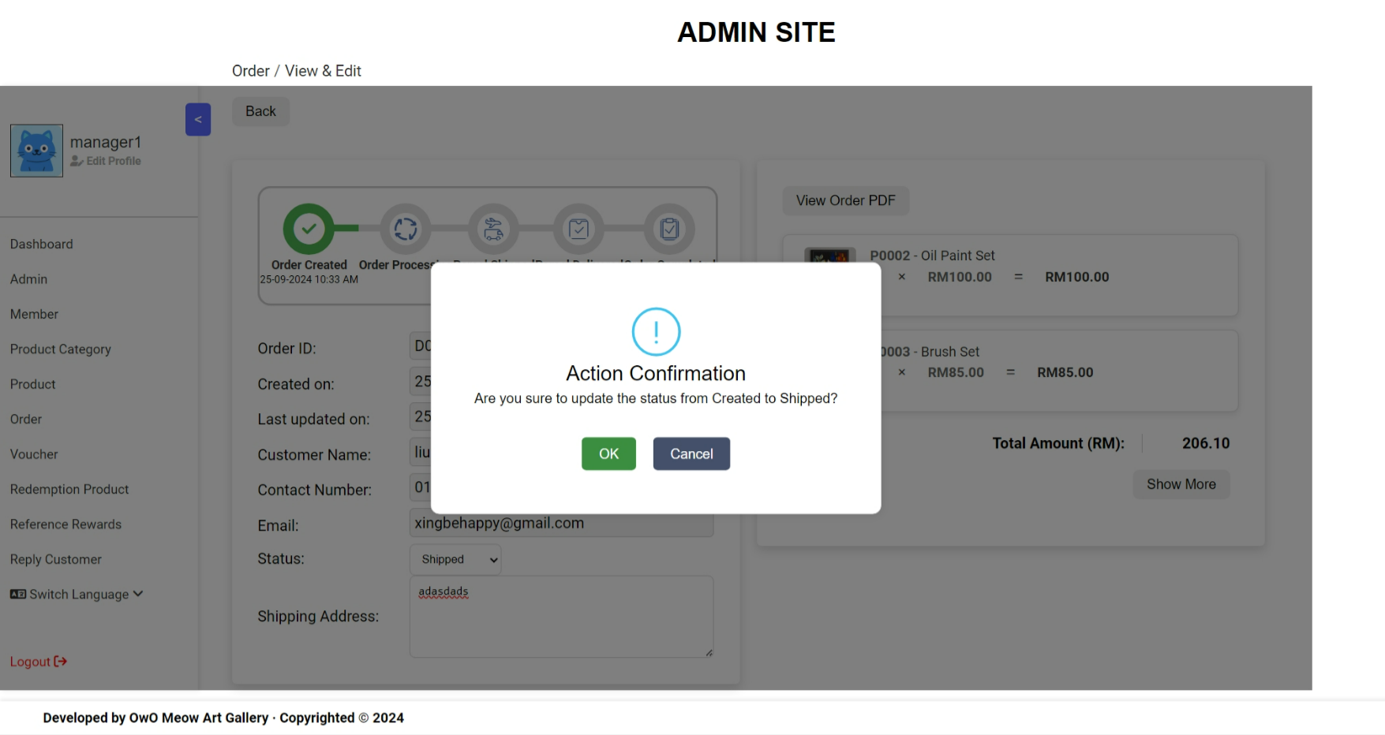
Update Order Status & Confirmation

Slide 61

Update Order Success

Slide 62

Send Email After Order Update Successfully

Slide 63

View Order PDF (Chinese Version)

Slide 64

View Order PDF (English Version)

Slide 65

Member Site Product

Slide 66

Member Site Product

Slide 67

Member Site Product Review

Slide 68

Member Site Product Review

Slide 69

Add Product to Wishlist

Slide 70

Member Site Wishlist

Slide 71

Remove Product from Wishlist

Slide 72

Bilingual Support (Home Page)

Slide 73

Bilingual Support (Product Page)

Slide 74

Bilingual Support (Voucher Page)

Slide 75

Bilingual Support (Cart Page)

Slide 76

Add Product to Shopping Cart

Slide 77

Shopping Cart

Slide 78

Batch Adding Product into Wishlist

Slide 79

Batch Removing Product from Shopping Cart

Slide 80

Payment by E-Wallet

Slide 81

Payment by Meow Wallet

Slide 82

Payment by Card with Integrated Stripe API

Slide 83

Payment Success

Slide 84

Payment Success Email Sended

Slide 85

Payment (Order Detail)

Slide 86
4. Ng Ian Kai

Slide 87
3. Ng Ian Kai
Product Maintenance (Admin)
Product Listing + Detail
Basic Searching
Product CRUD
Product Photo Upload
Activating product checks if the category is deactivated.
Record Listing (Table View + Photo View)
Image Processing (Flip, Rotate, etc.)
Drag-and-Drop Photo Upload
1 Product = Multiple Photos
Multiple Photos Upload
Product Photos Slider (Dynamic)
Product Stock Handling
Product Low-in-Stock Alert
Product Filtering (by Category)
Product Filtering (by Price Range)
Filtering, Sorting, and Paging (Combined)
Ajax Integration

Slide 88
3. Ng Ian Kai
Category Maintenance (Admin)
Category Listing + Detail
Basic Searching
Category CRUD
Filtering, Sorting, and Paging (Combined)
Deactivate category also deactivate all associated products.
Activating category allows to select the deactivated associated products to activate back.
AJAX Integration
Product Redemption Maintenance (Admin)
Product Redemption Listing + Detail
Basic Searching
Product Redemption CRUD
Filtering, Sorting, and Paging (Combined)
Record Listing (Table View + Photo View)
Image Processing (Rotate)
Ajax Integration

Slide 89

Product Maintenance

Slide 90

Create New Product

Slide 91

Edit Existing Product

Slide 92

Product Quantity Below Low Stock Threshold
When the product quantity is below low stock threshold, the system will send an email to admins and managers. The email alert will not be sent again until the quantity is above low stock threshold or it’s been 3 days, whichever comes first.

Slide 93

Activate Product which Category is Deactivated

Slide 94

Product Category Maintenance

Slide 95

Create New Product Category

Slide 96

Edit Existing Product Category

Slide 97

Deactivate Existing Product Category

Slide 98

Deactivate Category and Associated Products

Slide 99

Activate Category and Selected Associated Products

Slide 100

Redemption Product Maintenance

Slide 101

Create New Redemption Product

Slide 102

Edit Existing Redemption Product

